Slide 1
Flight Delay Prediction
-Abhishek raj sampath

Slide 2



INTRODUCTION
Due to the accompanying financial losses that the aviation sector is constantly experiencing, flight delays have become a very important topic for air transportation all over the world.
According to data from the Bureau of Transportation Statistics (BTS) of the United Stated, over 20% of US flights were delayed during 2018, which resulted in a severe economic impact equivalent to circa 41 billion US$.
These delays not only cause inconvenience to the airlines, but also to passengers. As the travel time increases, we can observe an in increase in expenses to the airlines(fuel consumption, aircraft repositioning etc) and to the passengers(food and lodging).
The reasons for these delays vary a lot going from air congestion to weather conditions, mechanical problems, difficulties while boarding passengers, and simply the airlines inability to handle the demand given its capacity.
Hence, in this project I will look at different ML algorithms including AdaBoost, XgBoost and Random forest to try to predict if a flight will be delayed or not before it is even announced on departure boards.

Slide 3
DATA GATHERING
The dataset comes from Kaggle, and it consists of a multi-year data ranging from 2009 to 2018 separated in 10 different files.
Each one of these datasets has 28 categories/features in average with a few million rows. Because of the size of each file, I chose to work with is only one, corresponding to the 2018. This one consists of 28 categories with just over 7.2 million rows.
The project considered features that are useful before the plane takes off.
The features to be avoided are TAXI_OUT, WHEELS_OFF, WHEELS_ON, TAXI_IN, ACTUAL_ELAPSED_TIME.
There is an additional feature that will bias the models, and that is the DEP_DELAY (Departure Delay.

Slide 4
glossary of all the features/categories available
FL_DATE = Date of the Flight OP_CARRIER = Airline Identifier OP_CARRIER_FL_NUM = Flight Number ORIGIN = Starting Airport Code DEST = Destination Airport Code CRS_DEP_TIME = Planned Departure Time DEP_TIME = Actual Departure Time DEP_DELAY = Total Delay on Departure in minutes TAXI_OUT = The time duration elapsed between departure from the origin airport gate and wheels off WHEELS_OFF = The time point that the aircraft's wheels leave the ground WHEELS_ON = The time point that the aircraft's wheels touch on the ground TAXI_IN = The time duration elapsed between wheels-on and gate arrival at the destination airport CRS_ARR_TIME = Planned arrival time ARR_TIME = Actual Arrival Time = ARRIVAL_TIME - SCHEDULED_ARRIVAL ARR_DELAY = Total Delay on Arrival in minutes CANCELLED = Flight Cancelled (1 = cancelled) CANCELLATION_CODE = Reason for Cancellation of flight: A - Airline/Carrier; B - Weather; C - National Air System; D - Security DIVERTED = Aircraft landed on different airport that the one scheduled CRS_ELAPSED_TIME = Planned amount of time needed for the flight trip ACTUAL_ELAPSED_TIME = AIR_TIME+TAXI_IN+TAXI_OUT AIR_TIME = The time duration between wheels_off and wheels_on time DISTANCE = Distance between two airports CARRIER_DELAY = Delay caused by the airline in minutes WEATHER_DELAY = Delay caused by weather NAS_DELAY = Delay caused by air system SECURITY_DELAY = caused by security reasons LATE_AIRCRAFT_DELAY = Delay caused by security

Slide 5

Data Preprocessing/Cleaning
The data preprocessing and cleaning was done in two notebooks to make it easier to follow up due to their length.
The first step before going into the data cleaning was to define what I will be considering a delayed flight.
Arrive late at its destination is the feature I will be considering.
Even if a flight has a delay from its departure, but still arrives to its destination on time, it will not be considered a delayed flight.

Slide 6
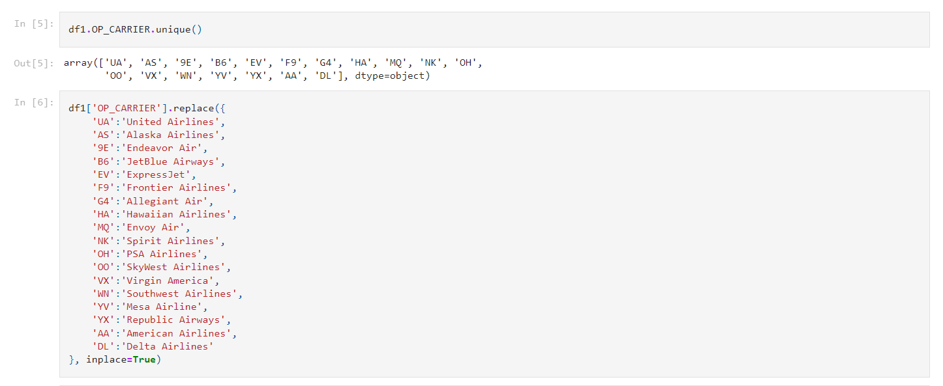
Data Preprocessing/Cleaning
Changed OP_CARRIER to the airlines extended names.
Fig.1 Inserting extended names

Slide 7
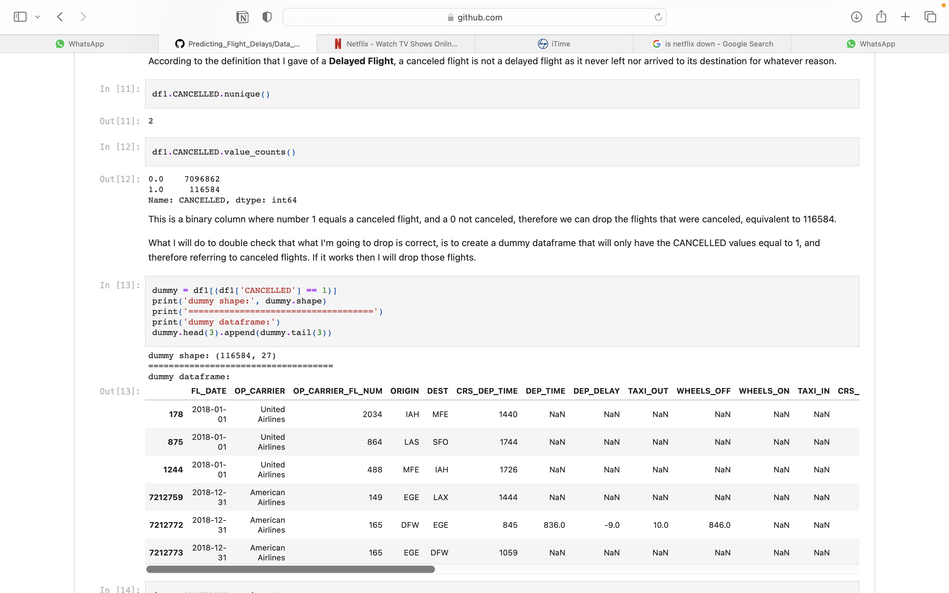
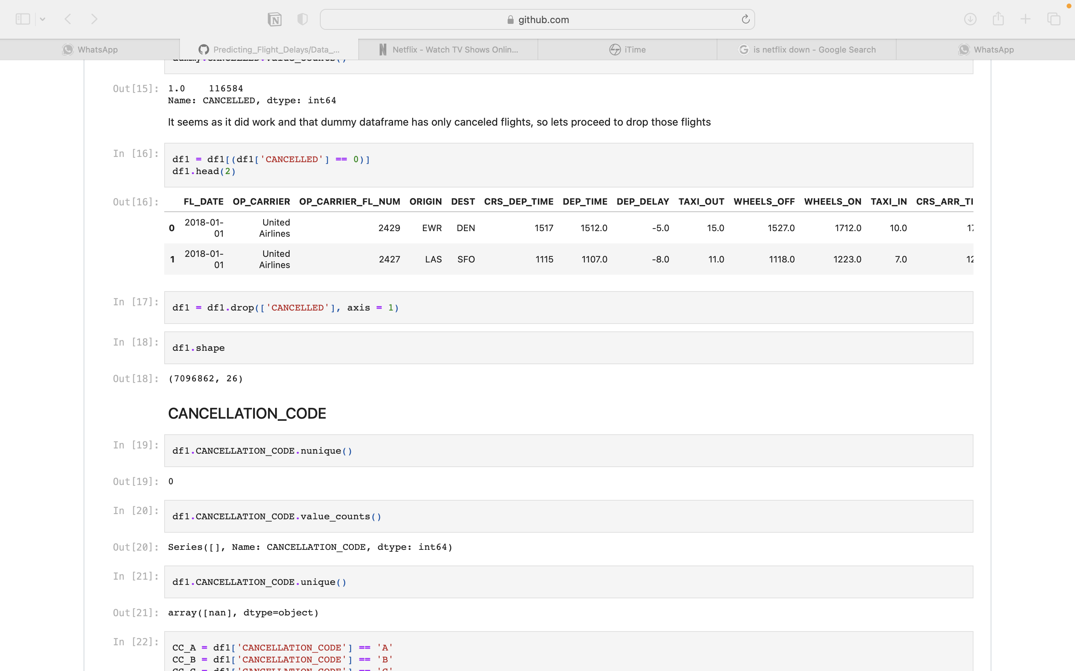
Data Preprocessing/Cleaning
A canceled flight will not be a delayed one either. Therefore, that column was dropped where the binary value is 1 which is considered as cancelled flight.
Fig 2. Assigning binary values to Cancelled and Non Cancelled flights.
Fig 3. Dropping columns with Cancelled flights.

Slide 8
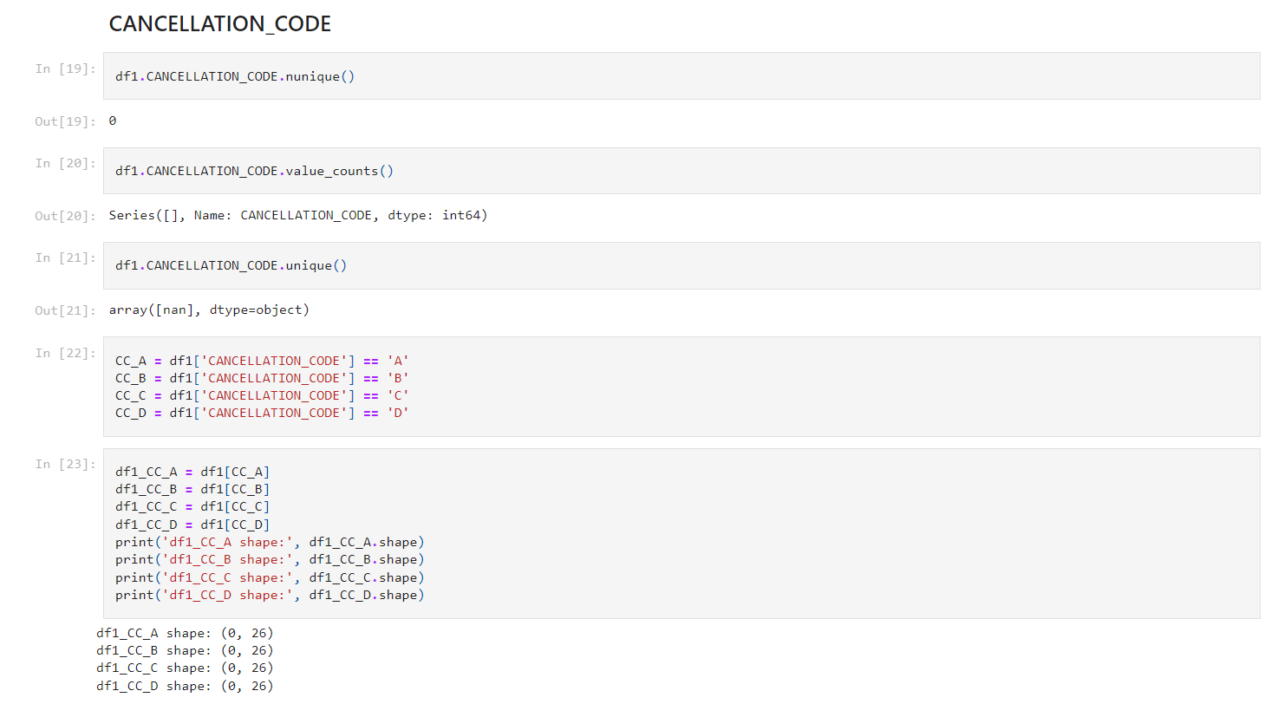
Data Preprocessing/Cleaning
CANCELLATION_CODE column is dropped since its empty.
Fig 4. Dropping cancellation code

Slide 9
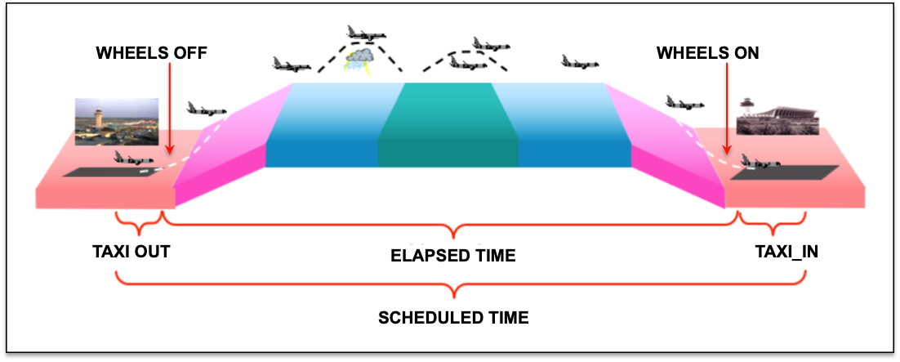
Data Preprocessing/Cleaning
Another set of features that were interesting but were not considered for the predictive modeling were the following four: TAXI_OUT, WHEELS_OFF, WHEELS_ON, TAXI_IN.
The IATA Codes were not mentioned properly in the original data frame. In order to over come this we merged the original data frame with a new csv “airports.csv”.
Fig 5. Explanation of features

Slide 10
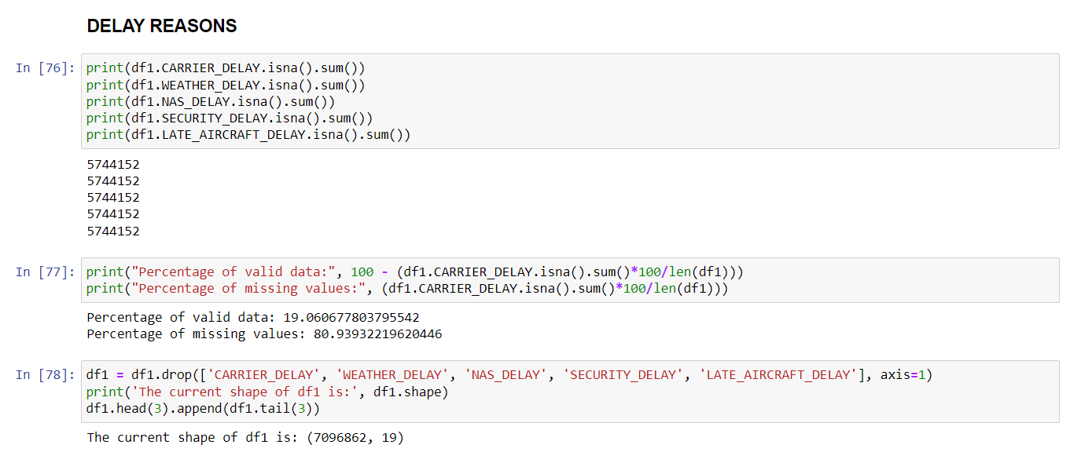
Data Preprocessing/Cleaning
These 5 are all reasons for the flights to be delayed, Almost 81% of the data corresponds to missing values and it is even across those 5 columns, and only 19% of data available. The decision is to drop these 5 columns
Fig 6. Five delay reasons

Slide 11
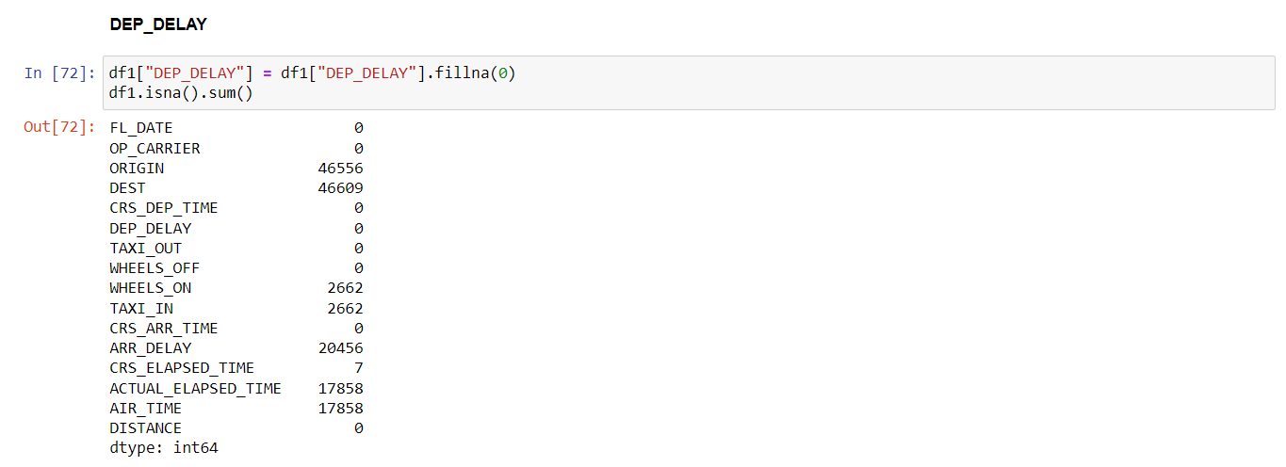
Data Preprocessing/Cleaning
After merging, we got our final data frame and we did further cleaning like removing the missing values etc.
The DEP_DELAY refers to the "Departure Delay", which is the difference between DEP_TIME (Actual Departure Time) and the SCH_DEP_TIME (Scheduled Departure time), therefore, if there are no delays for the departure, then the DEP_DELAY equals 0 (zero), and this is when it ends up being a NaN.
Fig 7. replacing NAN

Slide 12
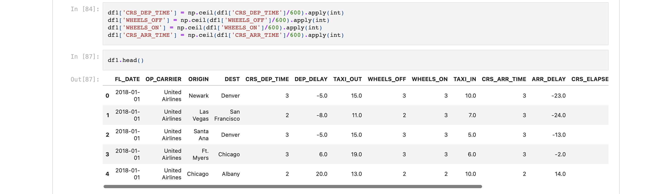
Data Preprocessing/Cleaning
Time is normally a categorical and having it in the current format will give us too many columns when the hot encode is applied to them, therefore I split the time into 4 quarters of the days meaning of 6 hours each.
Fig 8. Pre-processing time related columns.

Slide 13
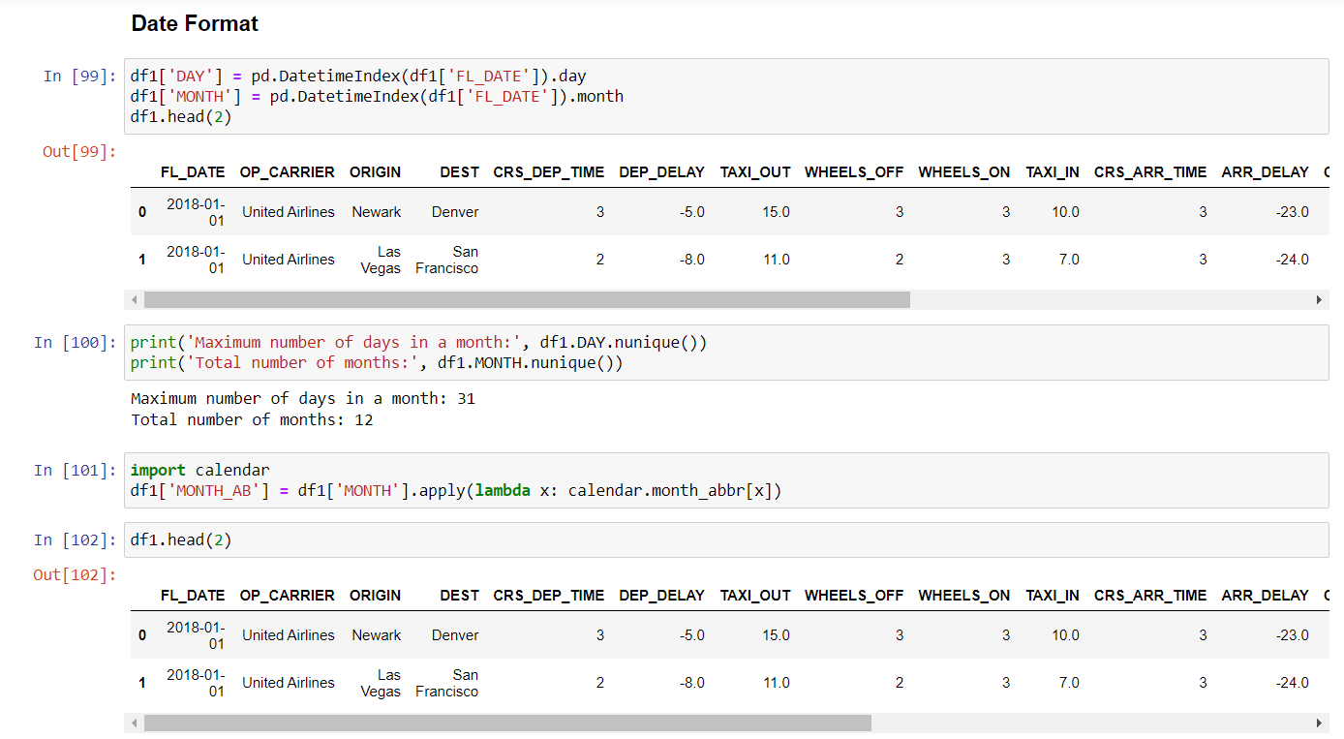
Data Preprocessing/Cleaning
Splitting Date for the purpose of EDA. Using the month values to analyze which are the best and worst months to travel in terms of delays, the numerical (int) month value is converted into the month abbreviation.
Fig 9. Splitting Data for the purpose of EDA

Slide 14
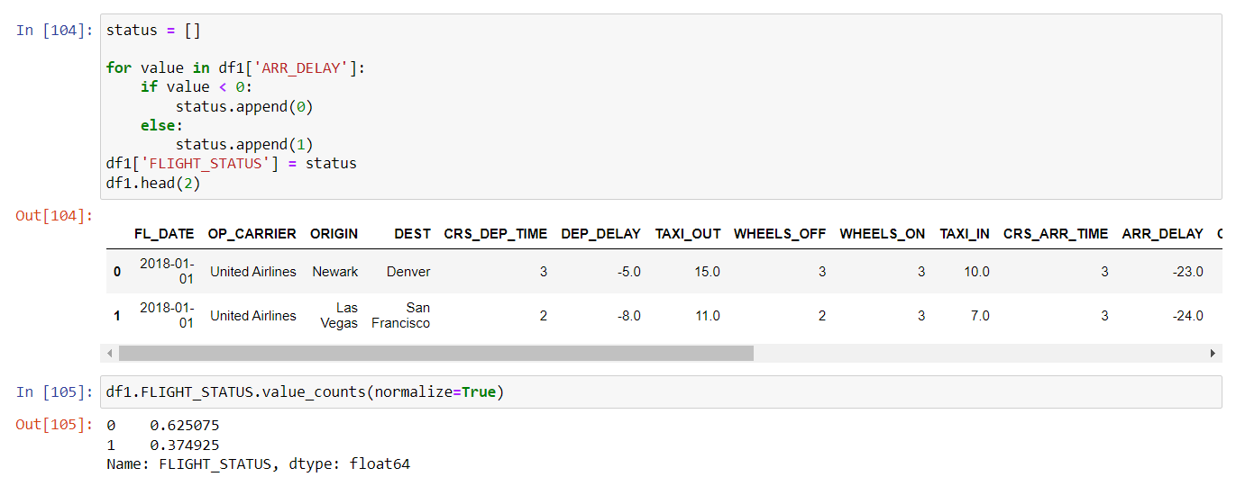
Data Preprocessing/Cleaning
Giving the FLIGHT_STATUS column binary values for the purpose of modelling, 0 for flights that arrive either earlier or on time, and a 1 for flights that are delayed.
Fig 10. Assigning Binary Values for Arr_delay

Slide 15
Data Preprocessing/Cleaning
The second part of Data pre-processing focuses on the EDA. Since, the dataset is very large, only top 20 cities were taken into account.
In order to do this, the “DEST” column was used as a categorical column. The hot encoding will then be done for this 20 instead of all the total destinations.
Once the numpy array for the top 20 cities was obtained, it was then converted to a list using the “.tolist()” function.
This list was then used to filter the main dataframe (df) and create a new one called dfm which stands for "datafame for modeling”.
Once the values in the new data frame matched the list we created, it was verified that the values of the top 20 cities are unique.
Now, the dataset was reduced from 7.07 million rows to 4 million as only top 20 cities were considered.

Slide 16
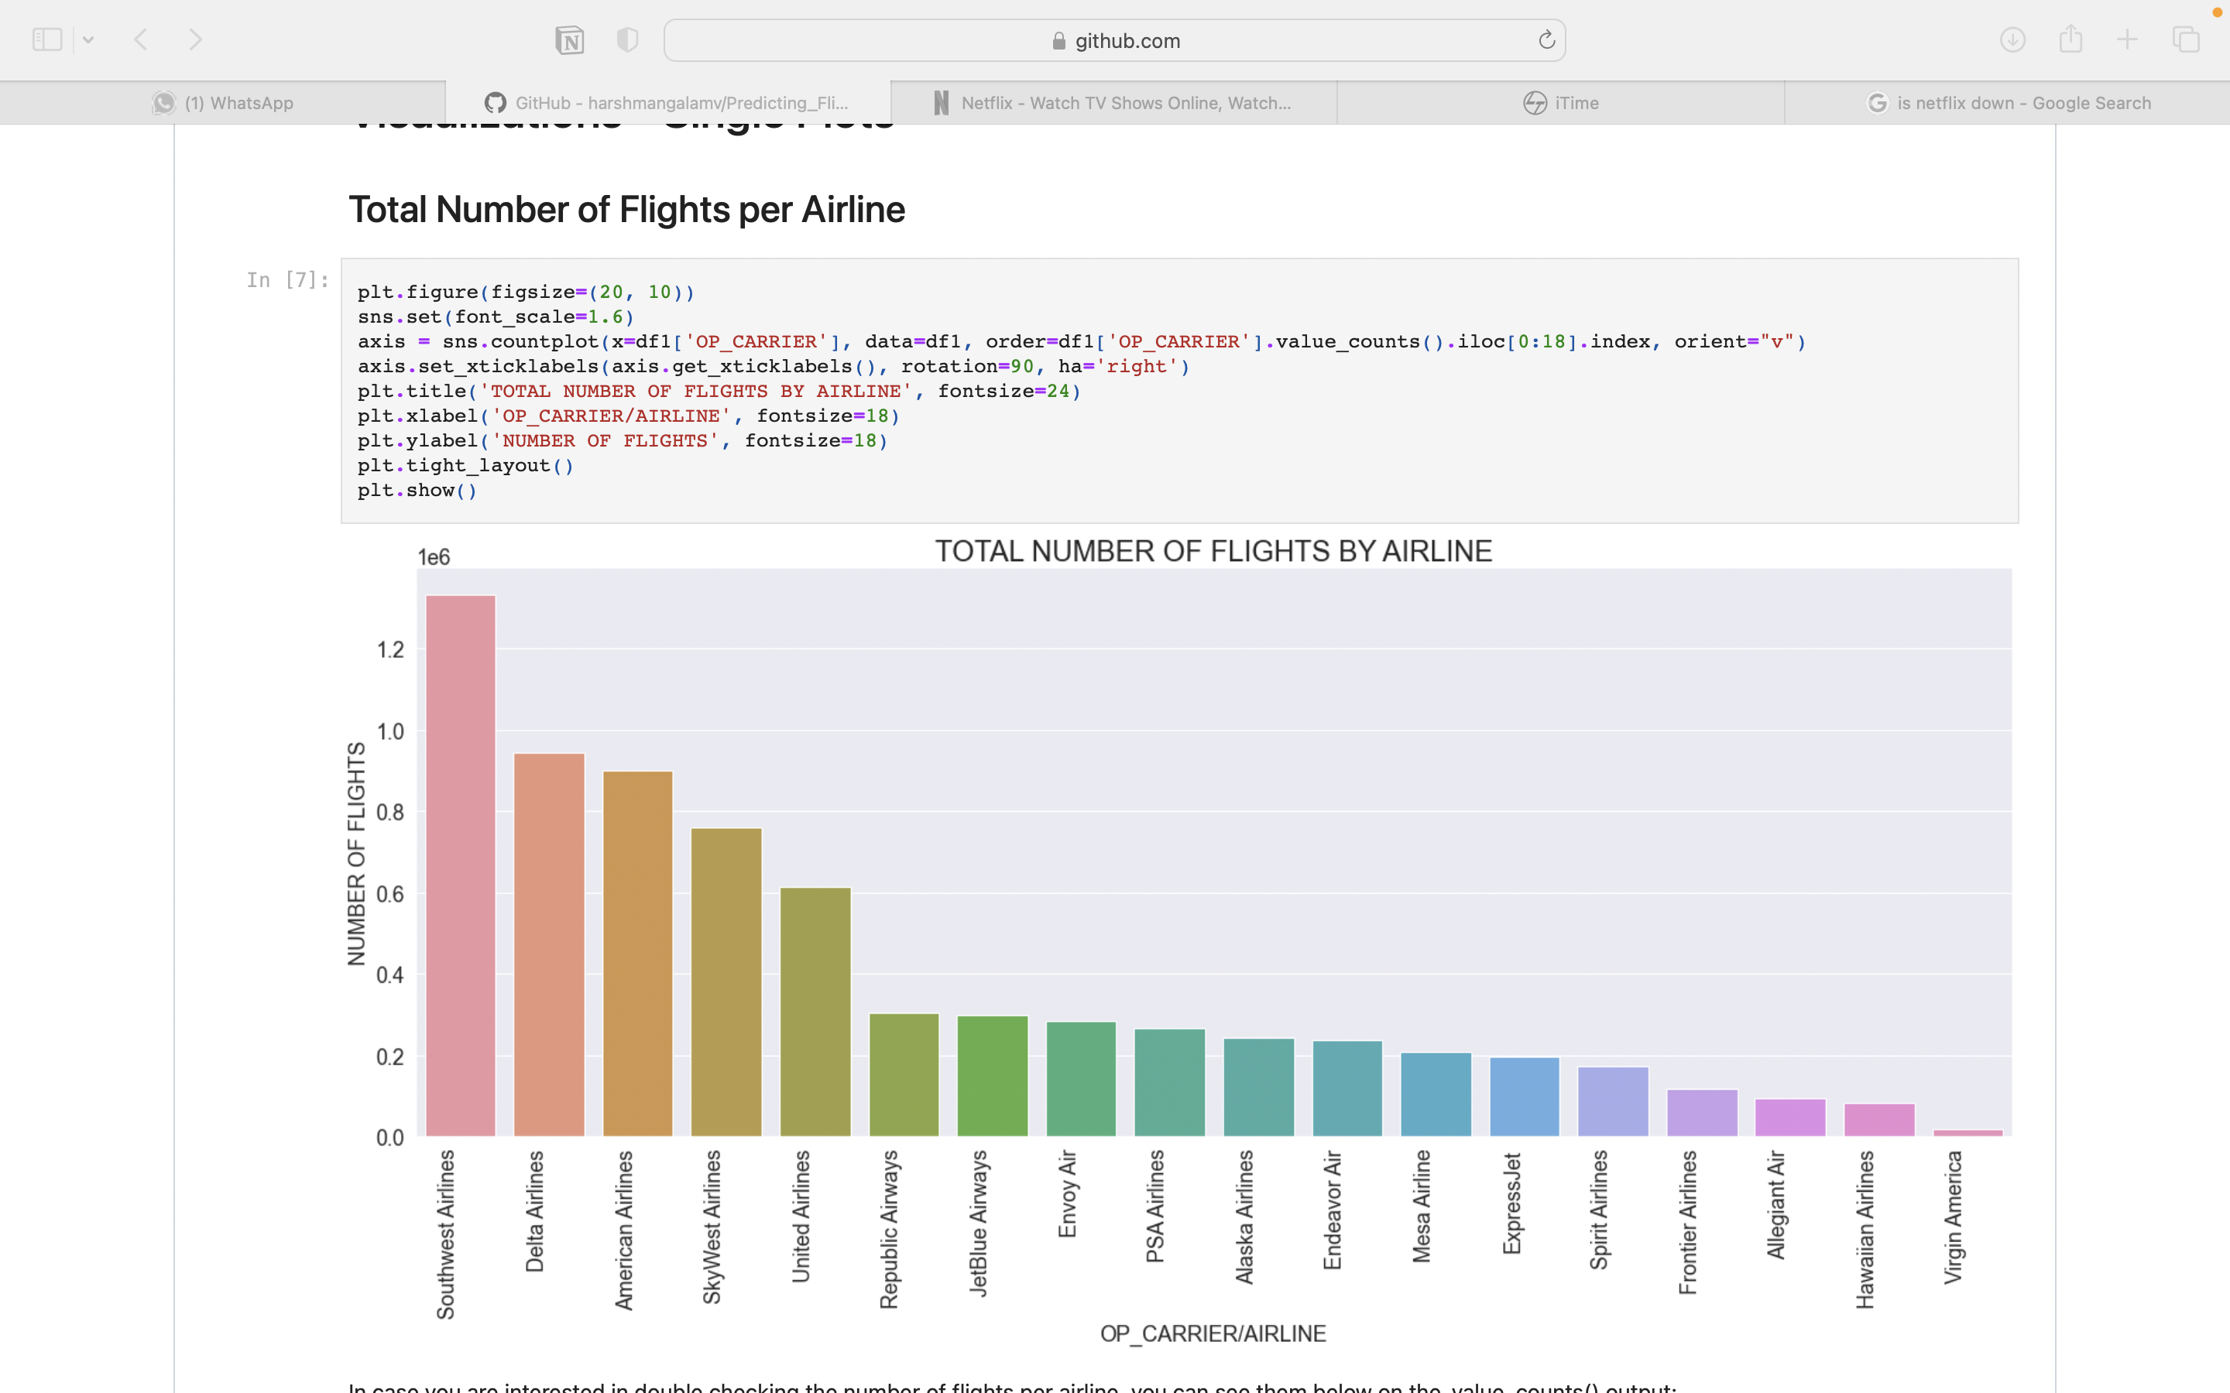
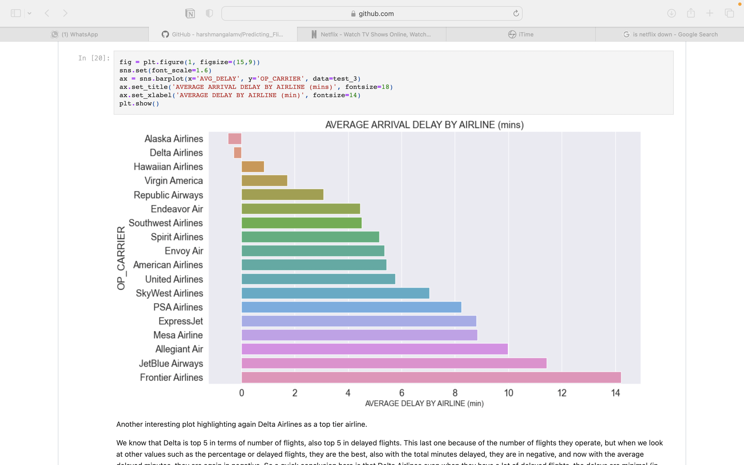
The measure of X- axis is Average delay by Airline in minutes and Y-axis is Airline names
Fig 12. Average arrival delay by airline
Fig 11. Total number of flights per Airline
The measure of X- axis is Airline names and
Y-axis is percentage of Number of flights

Slide 17
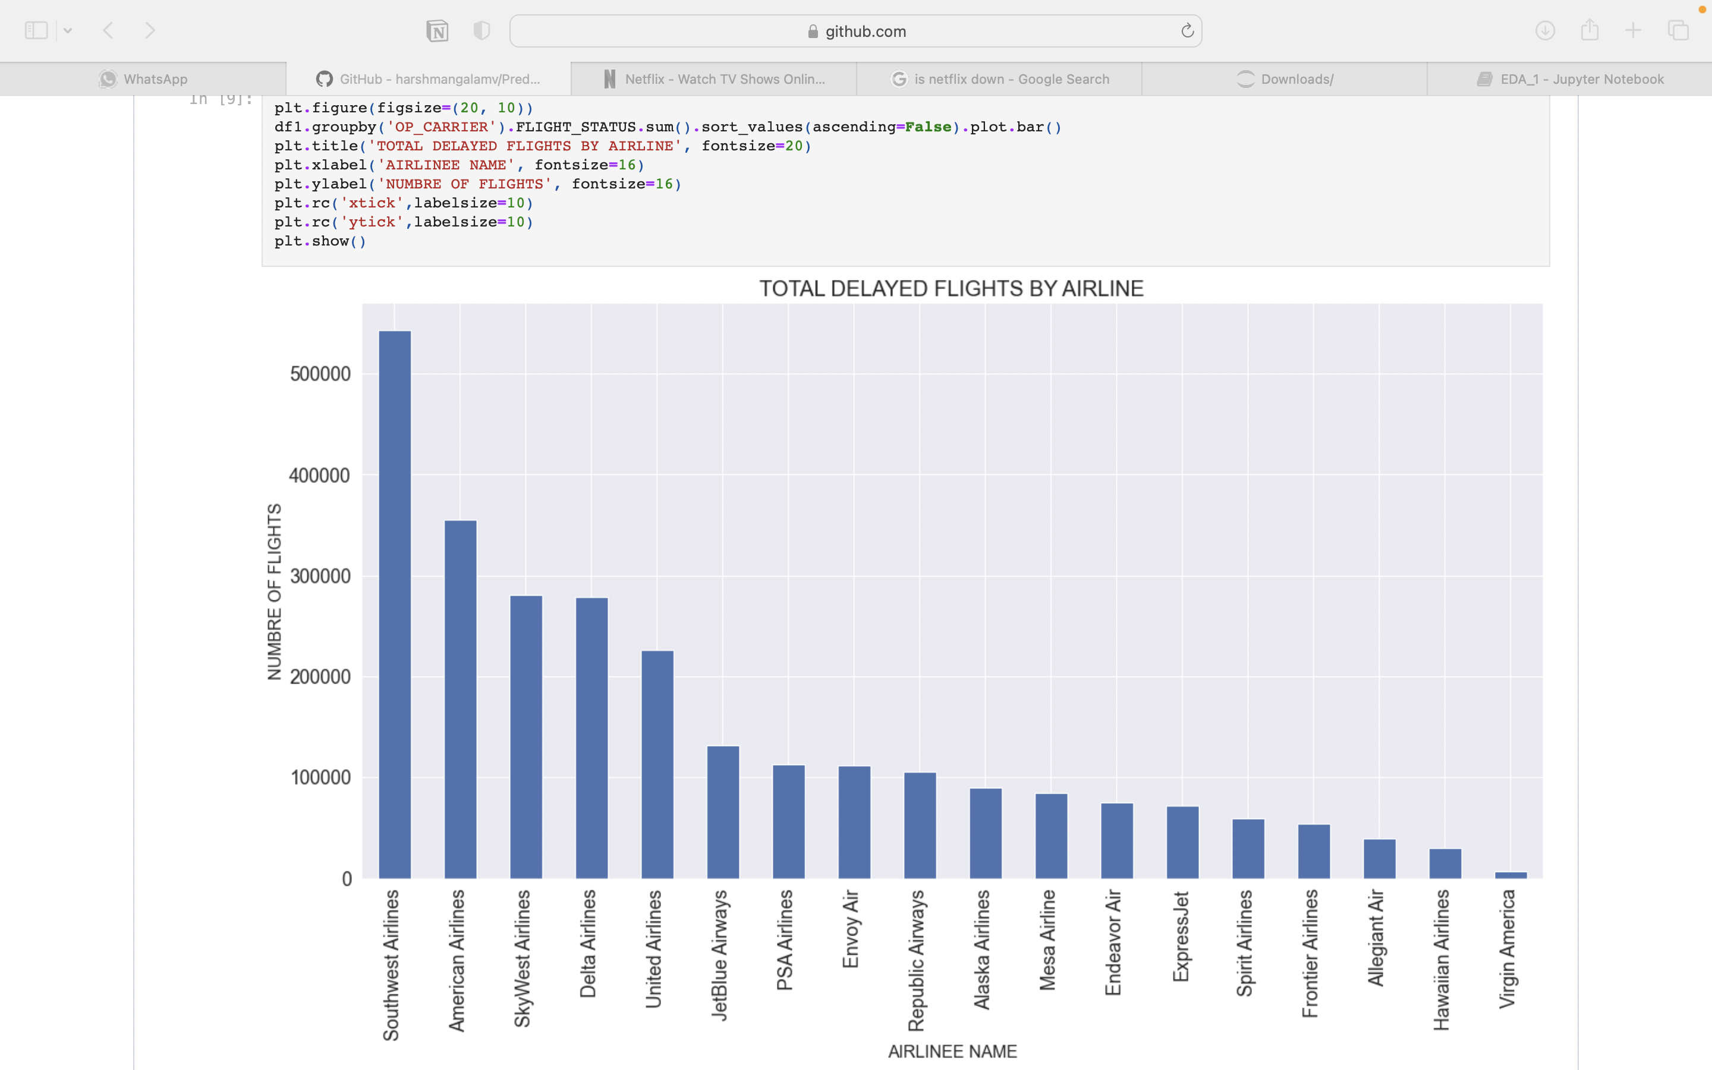
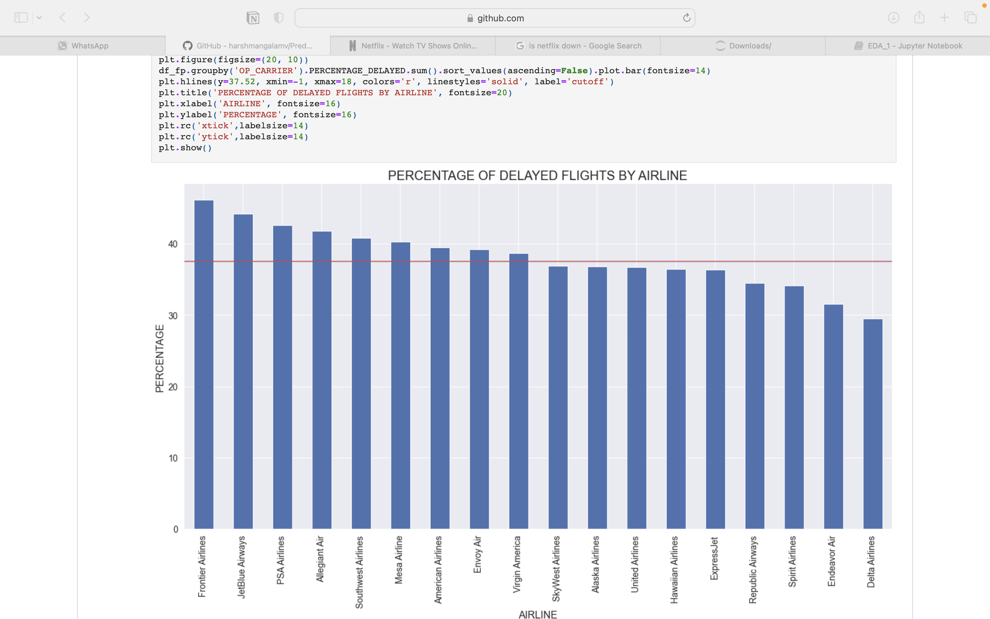
The measure of X-axis is Airline Names and Y- axis is Percentage of delayed flights by Airline
Fig 14. Percentage of delayed flights by Airline
Fig 13. Total delayed flights by Airline
The measure of X-axis is Airline Names and Y- axis is Total number of flights.

Slide 18
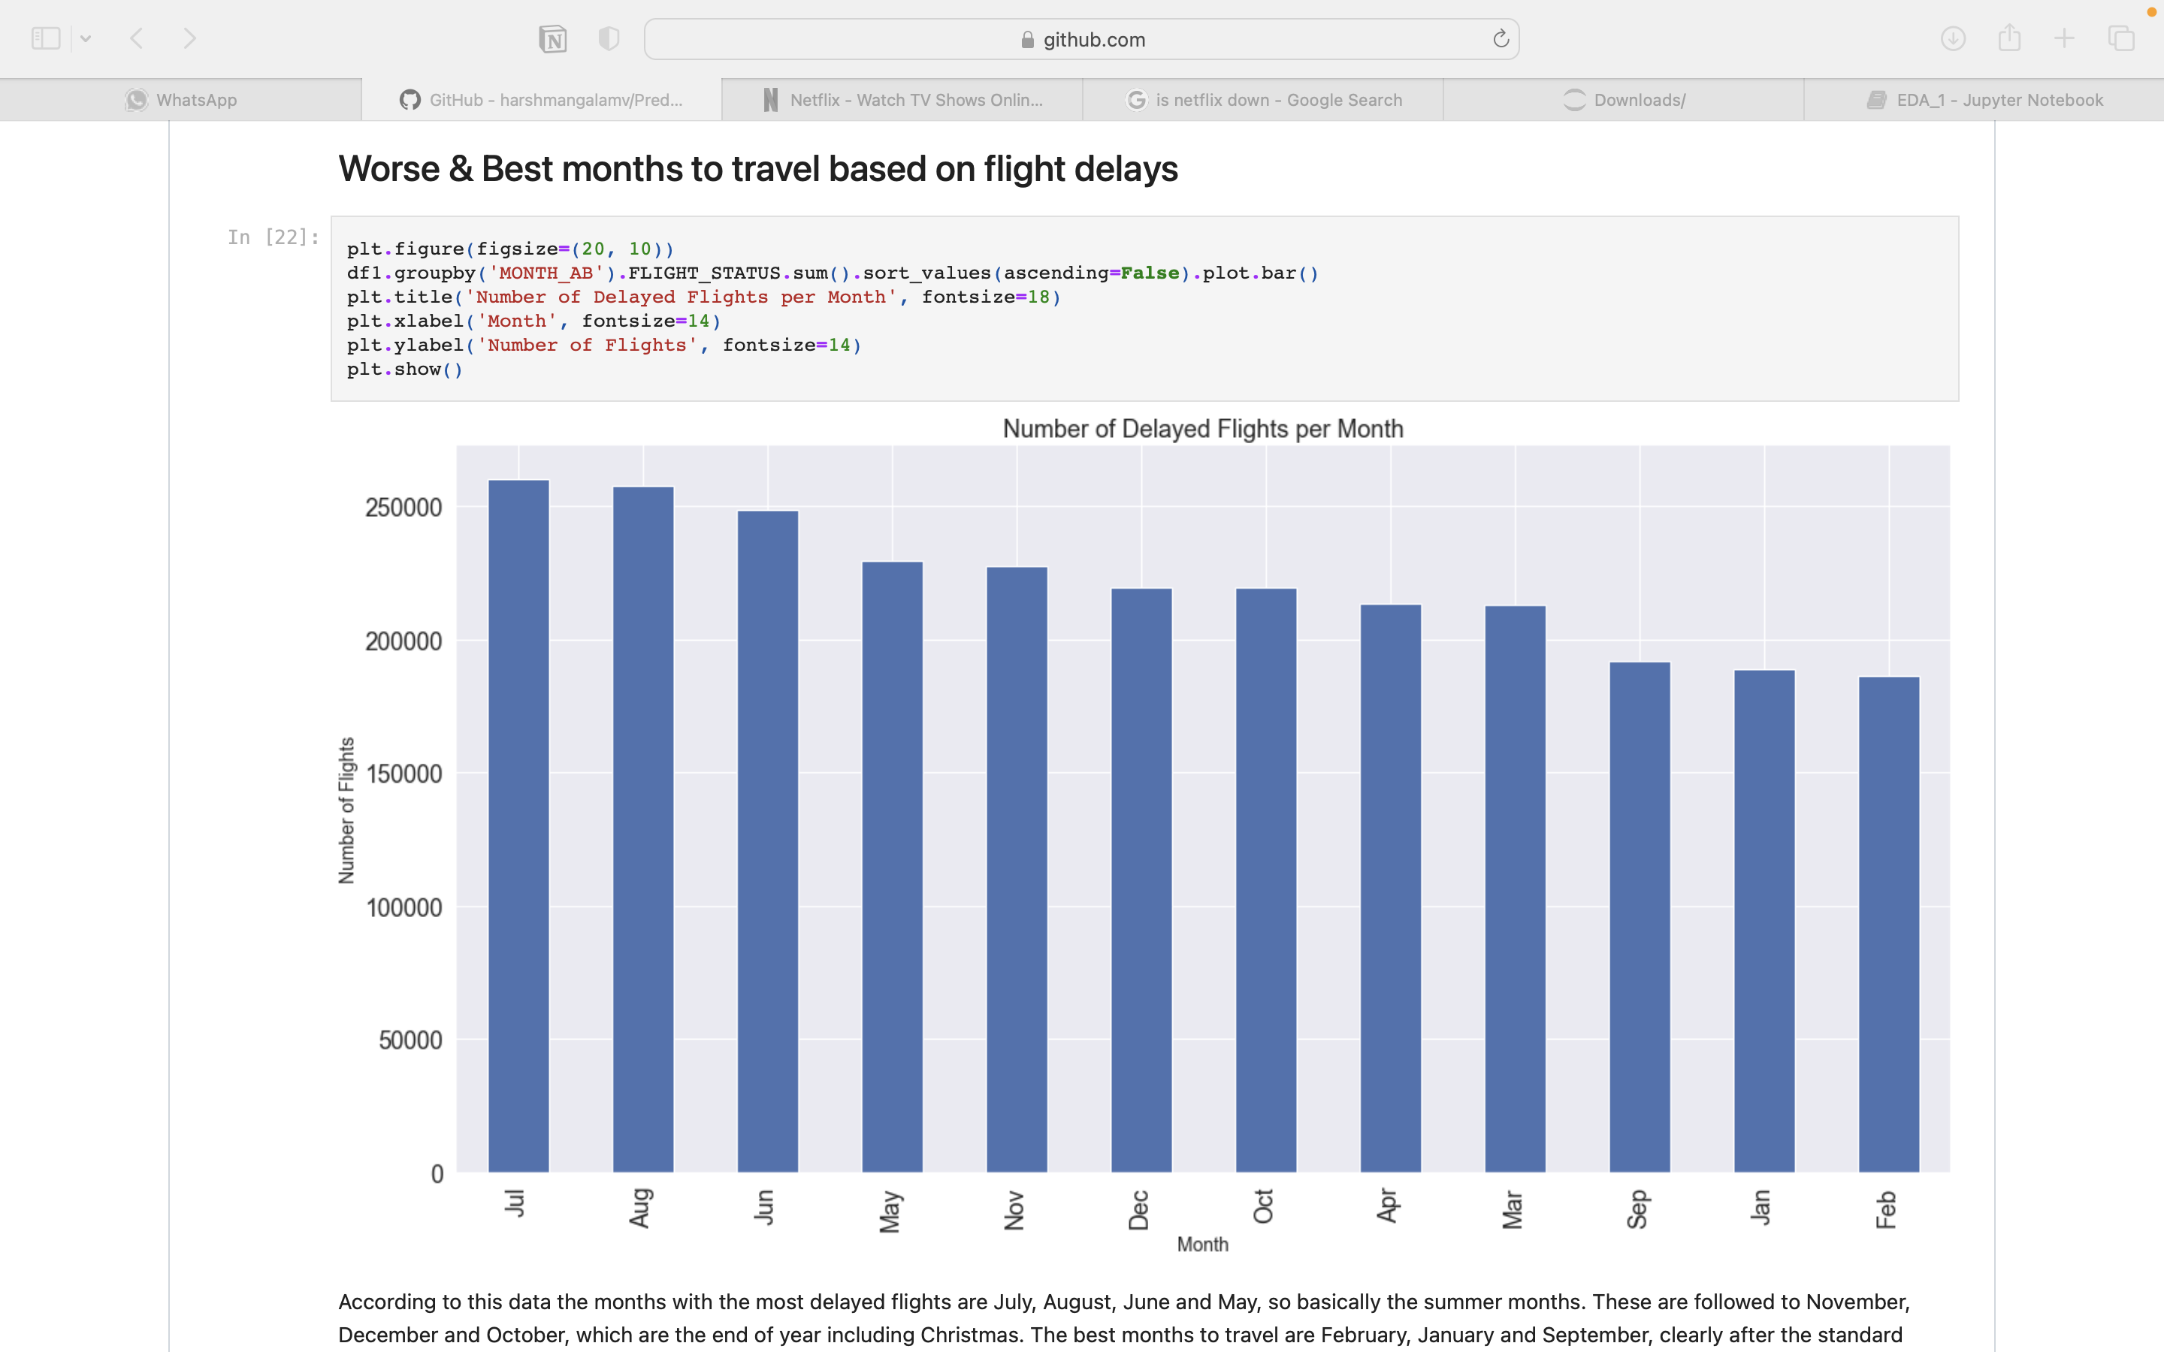
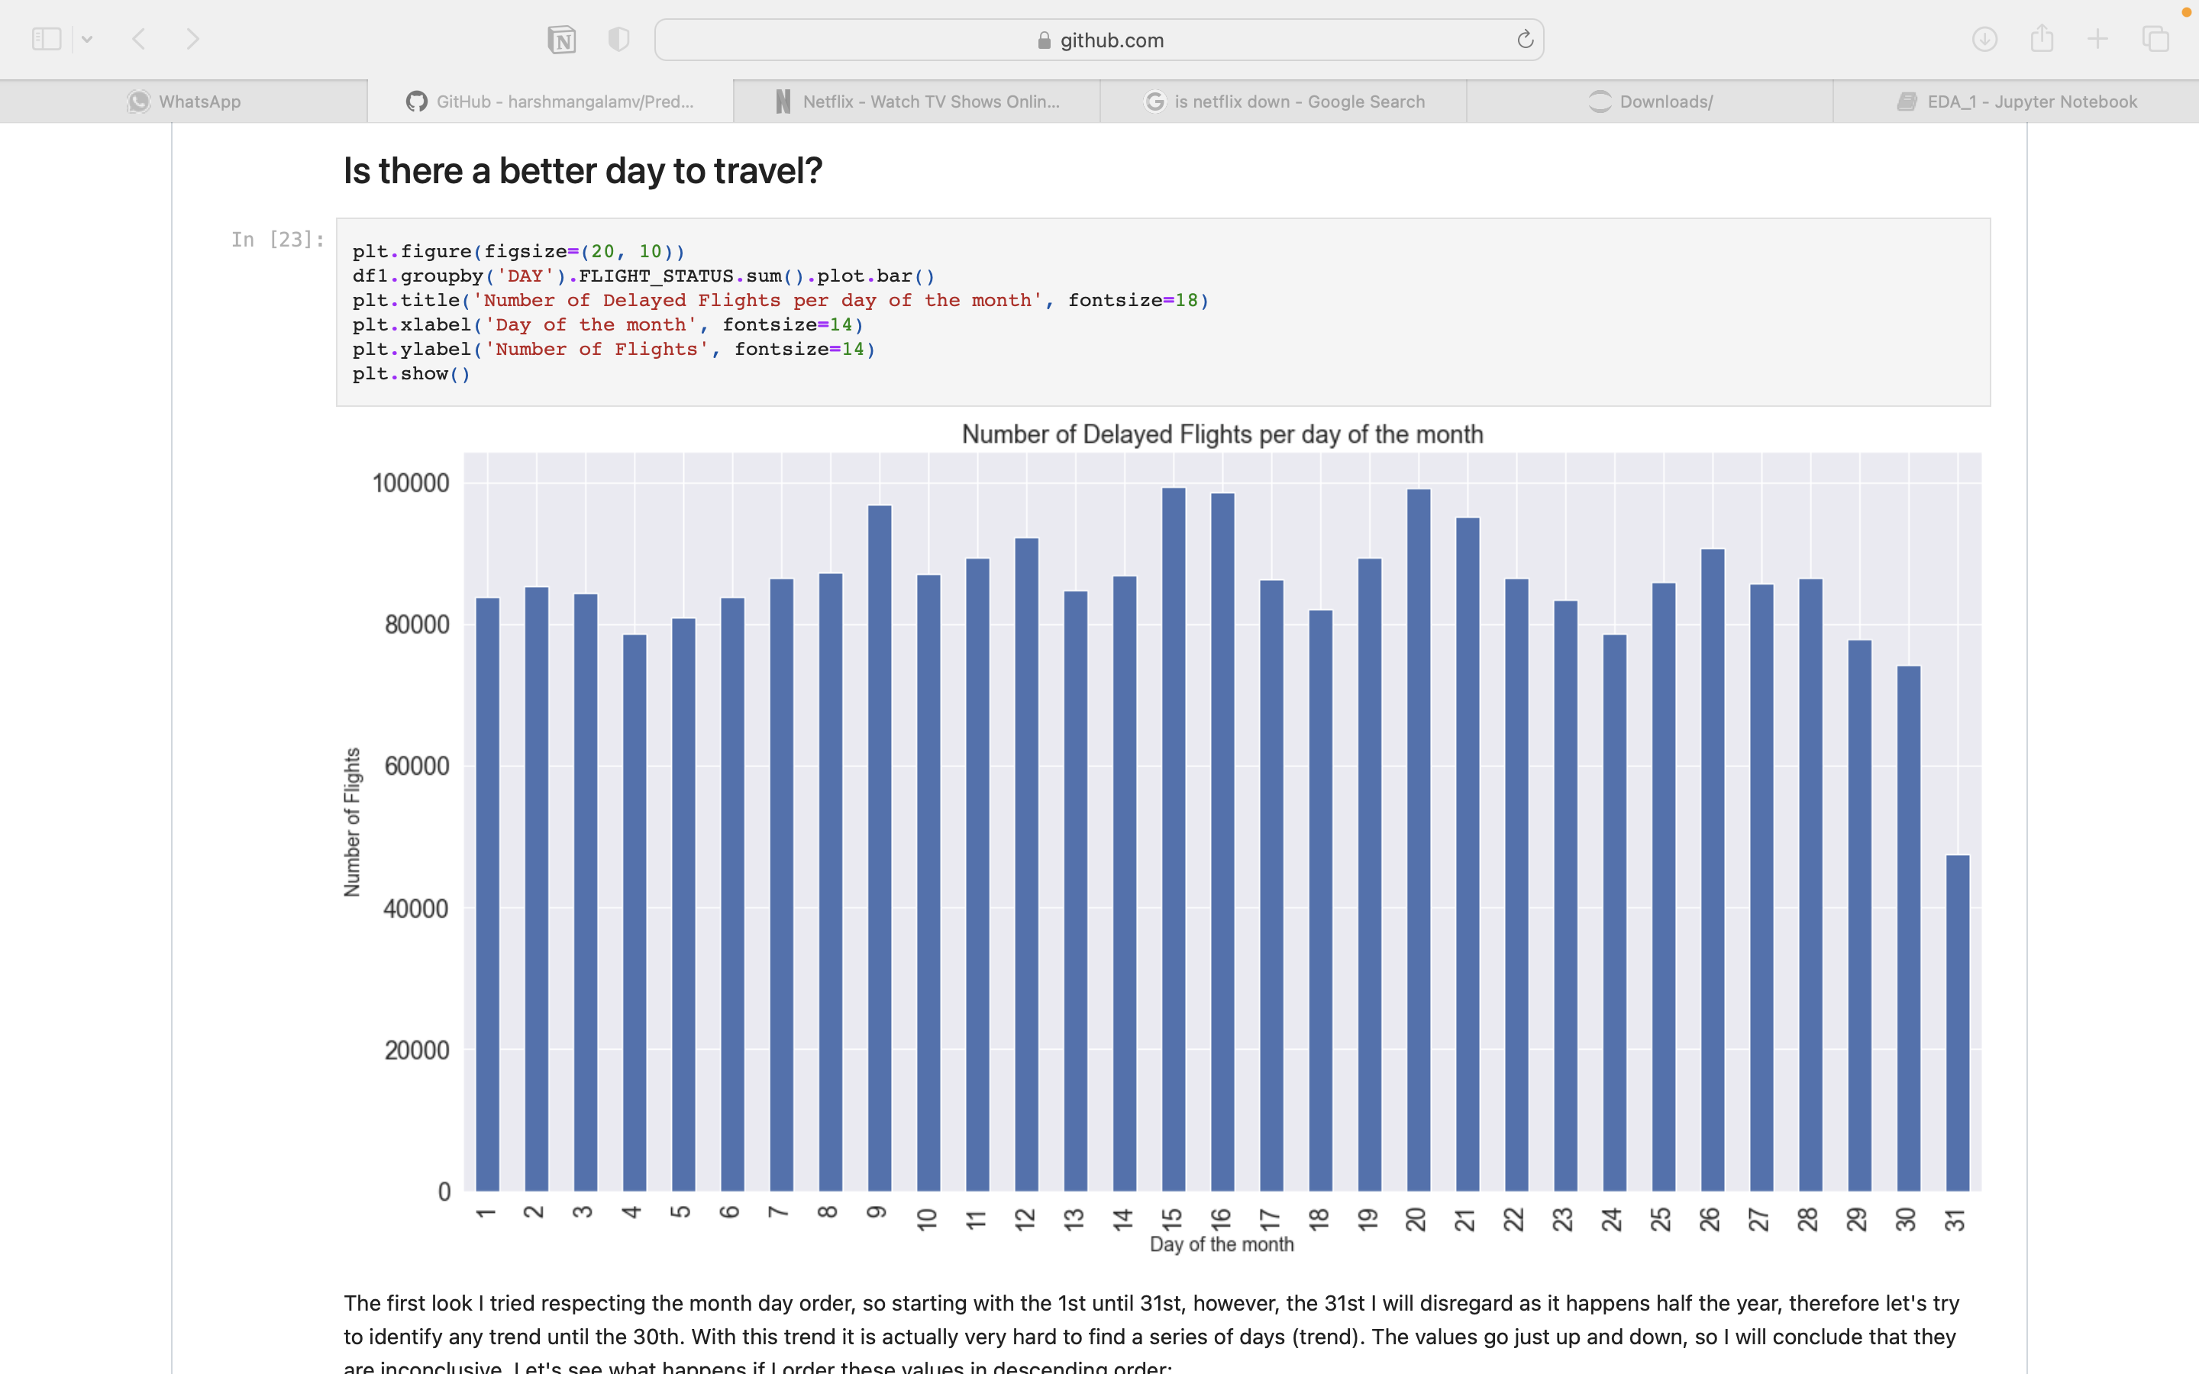
The measure of X-axis is Day of the Month and
Y- axis is Total number of flights delayed per day of the month.
Fig 16. Better days to travel
Fig 15. Worse and best months to travel based on flight delays
The measure of X-axis is Months and Y- axis is Total number of flights delayed.

Slide 19
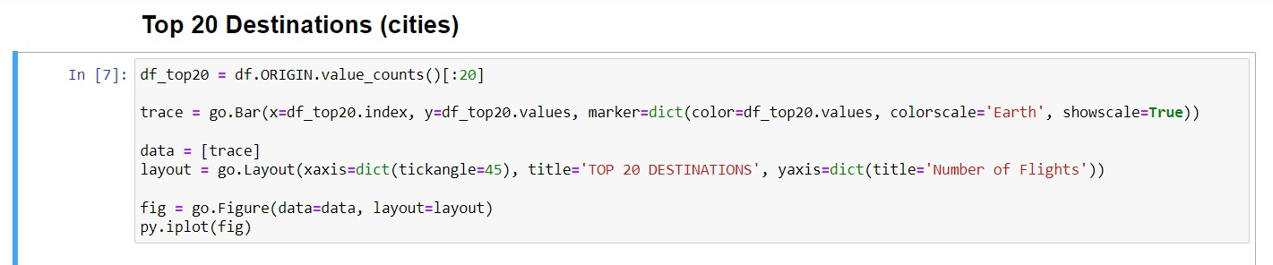
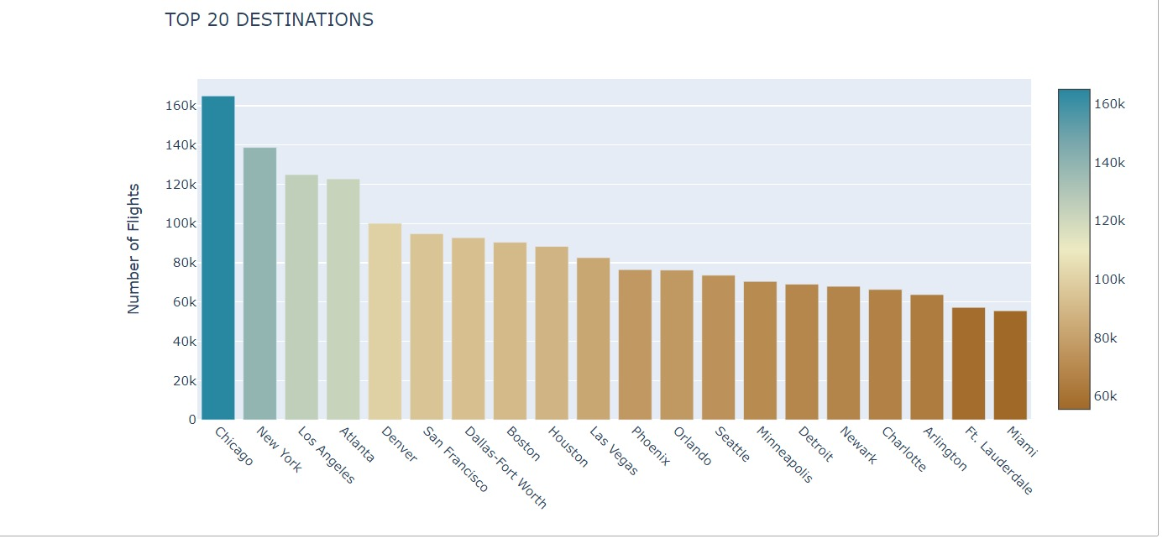
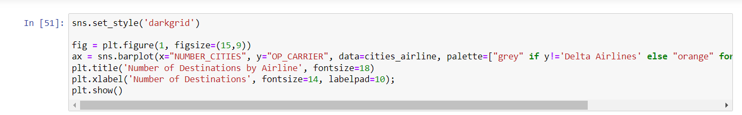
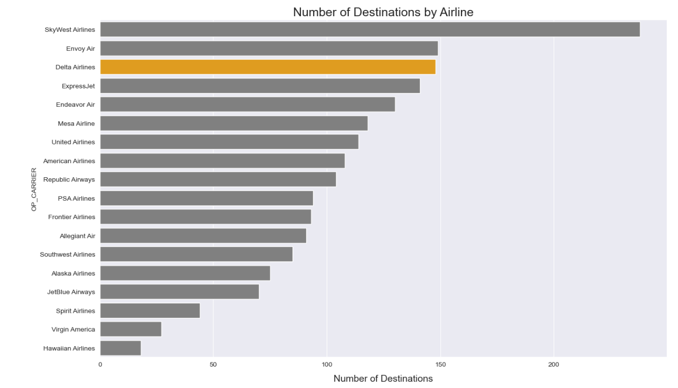
The measure of X-axis is Number of Destinations and Y- axis is Airline Names.
Fig 18. Number of Destinations by Airline
Fig 17. Top 20 cities
The measure of X-axis is Destination Names and Y- axis is Total number of flights.

Slide 20
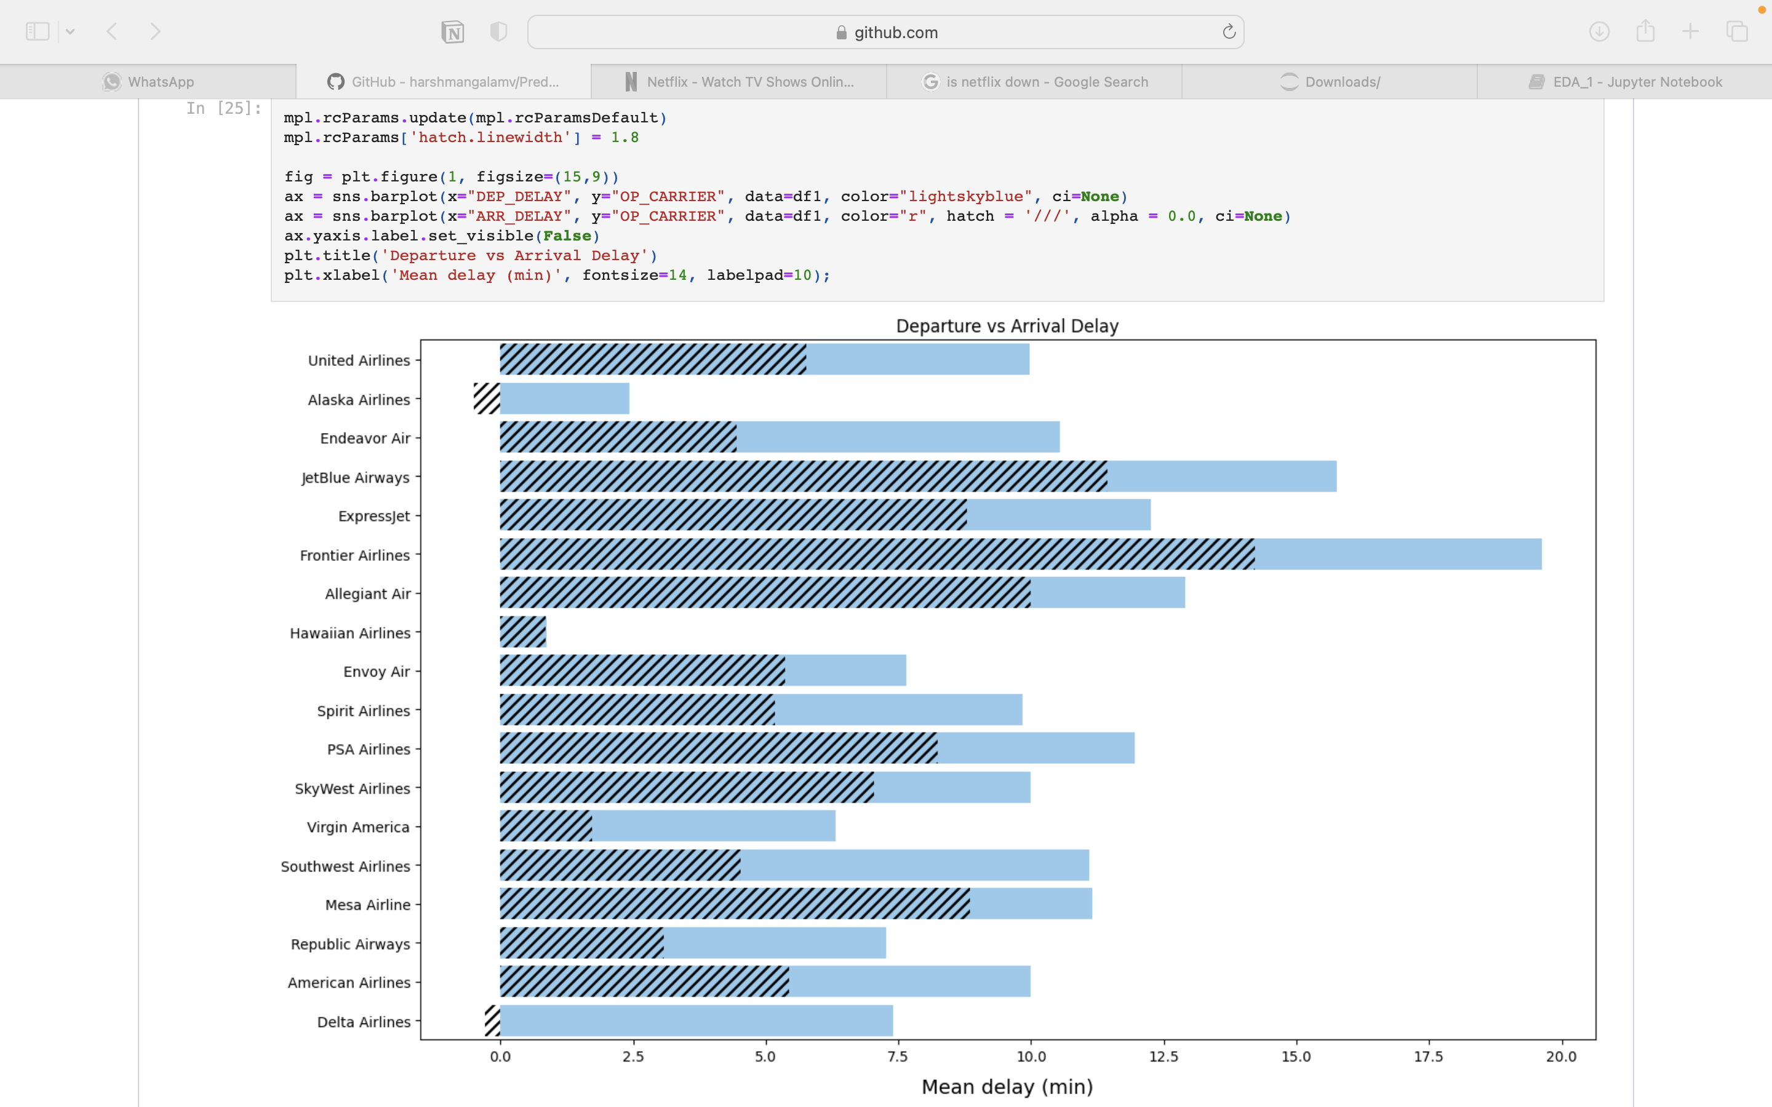
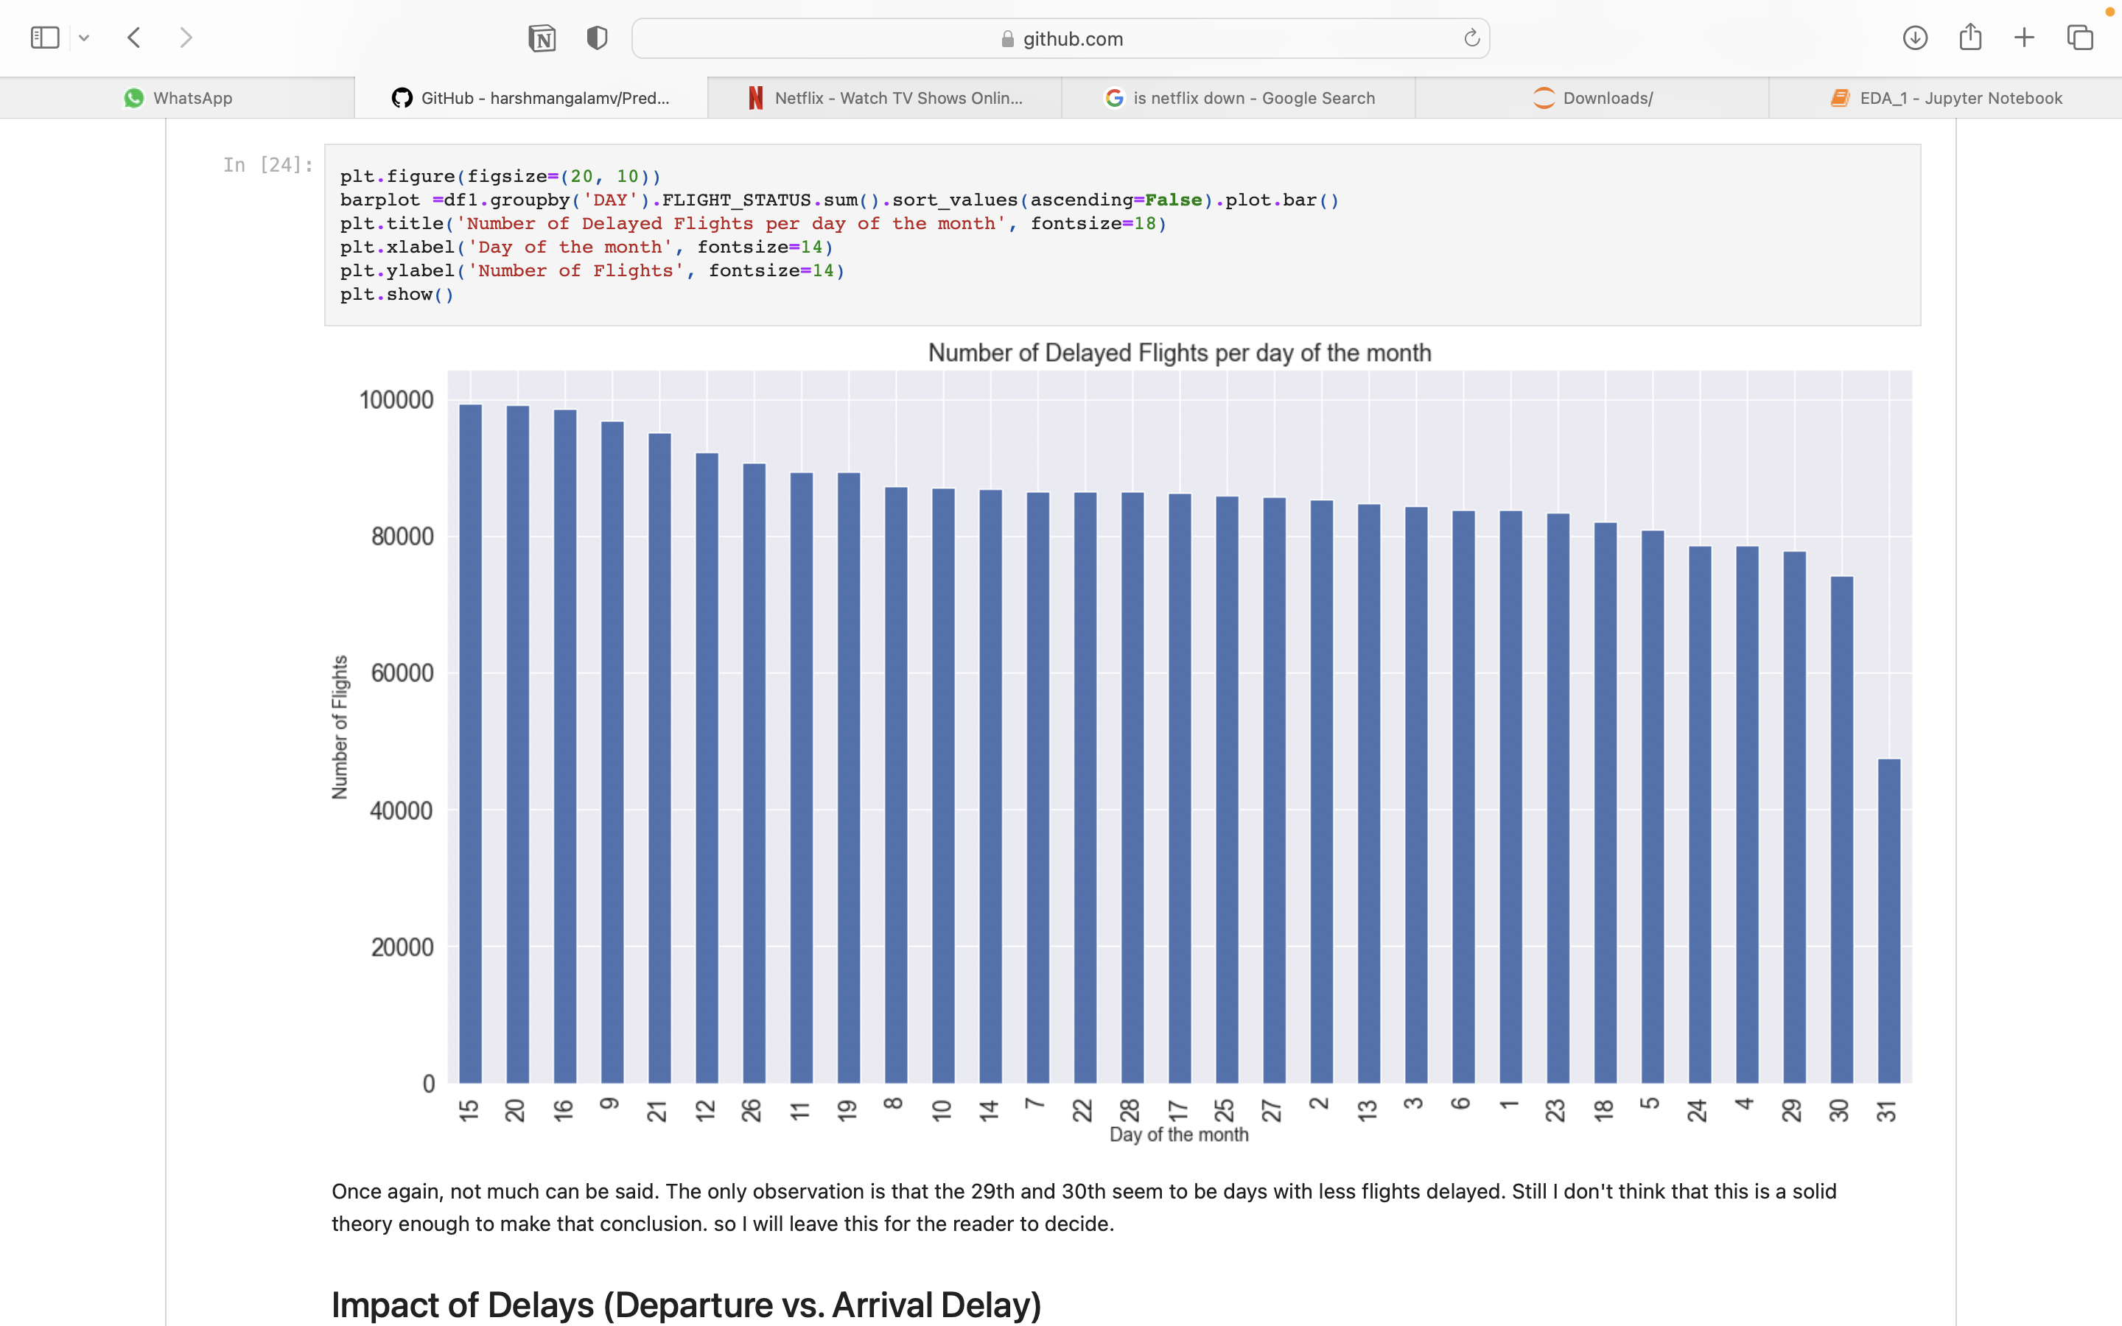
The measure of X-axis is Day of the Month and Y- axis is Total number of flights.
Fig 20. Number of delayed flights per day of the month
Fig 19. Departure Vs Arrival Delay
The measure of X-axis is Airline and Y- axis is Total number of flights.

Slide 21
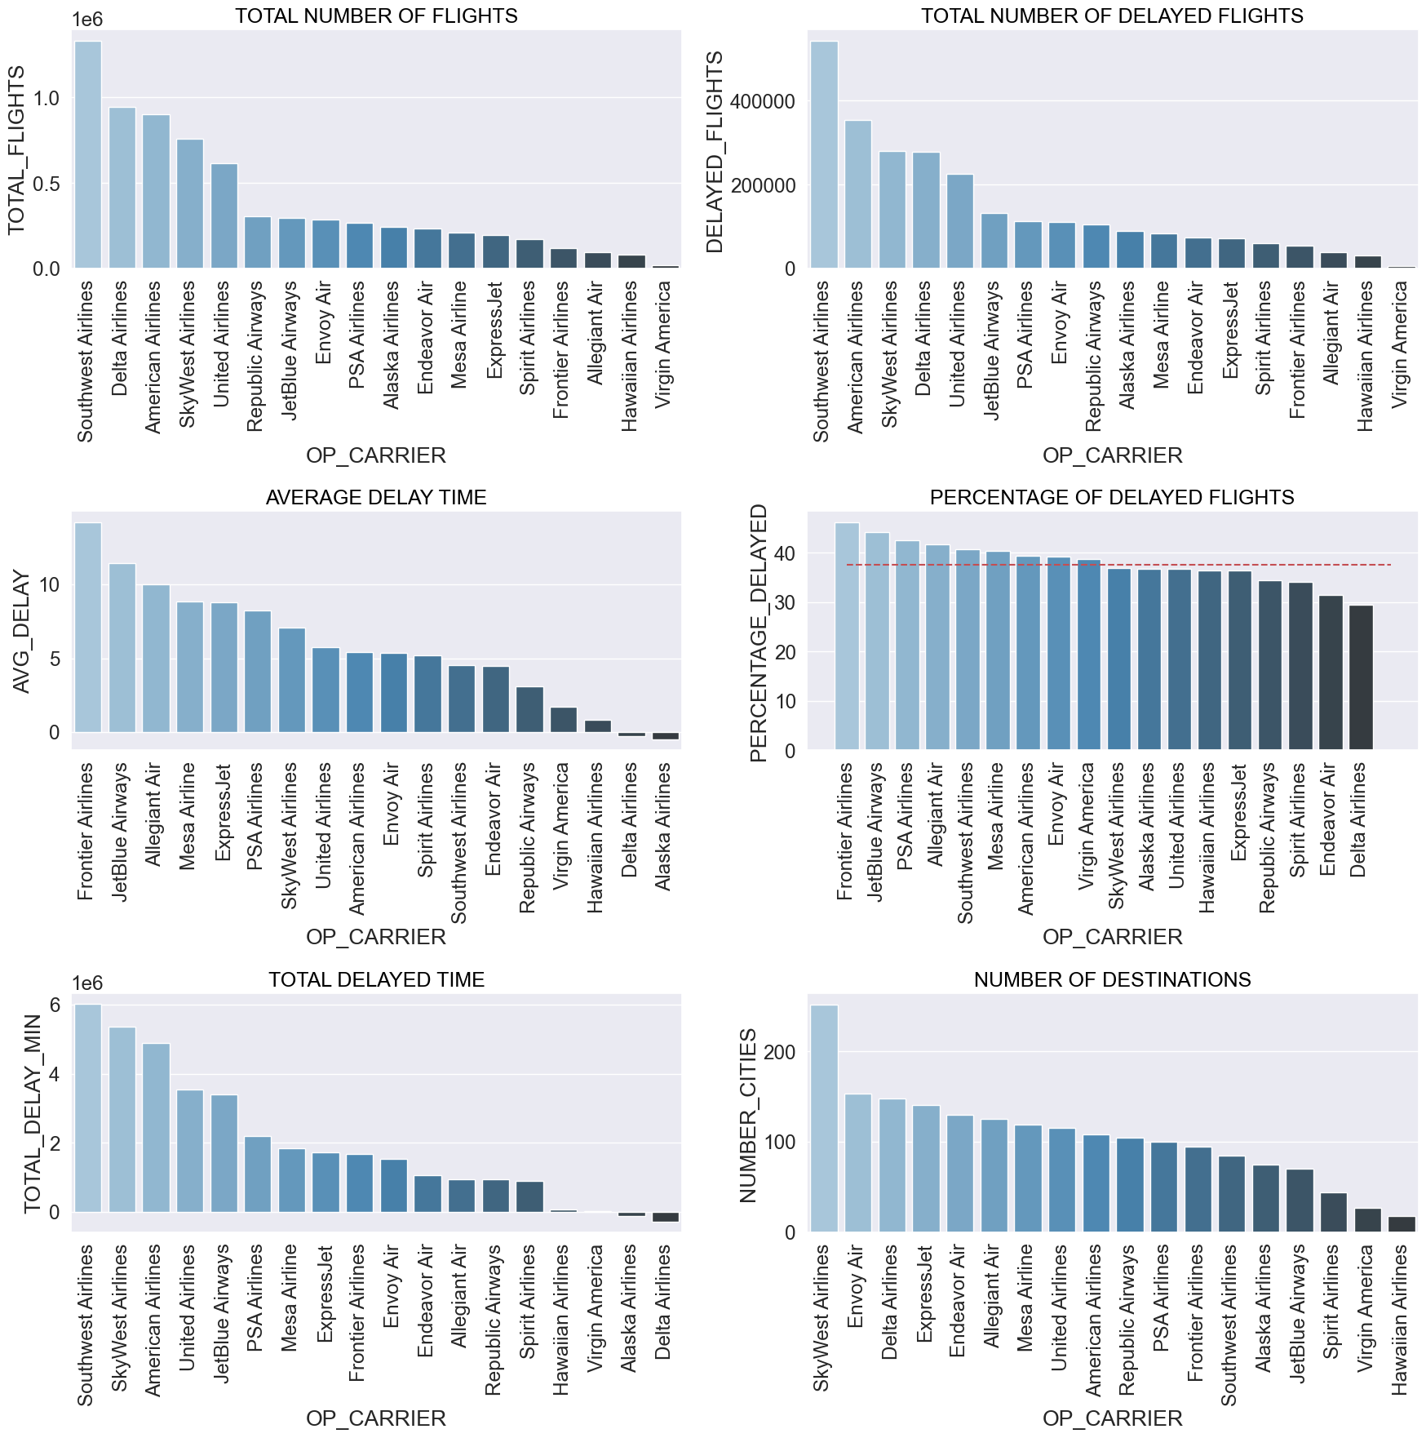
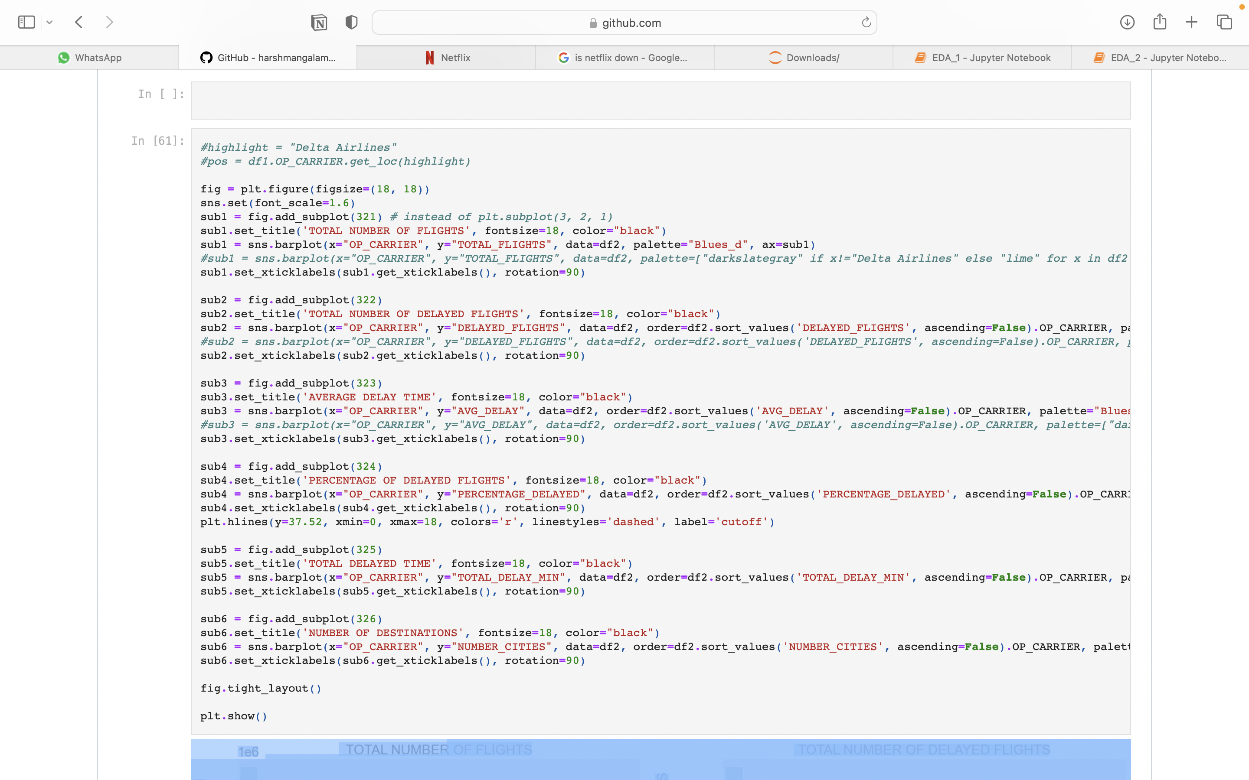
Fig 21. Code for plotting histograms
Measures:
Total Number of Flights: X- axis is Airline Names, Y- Axis is Percentage of Total flights.
Average Delay Time: X-axis is Airline Names, Y-axis is Average delay.
Total Delayed Time: X-axis is Airline Names, Y-axis is Total Delays in minutes.
Percentage of Delayed Flights: X-axis is Airline Names, Y-axis is Percentage of Delay(min).
Number of Destinations: X-axis is Airline Names, Y-axis is Number of cities.
Fig 22. Histograms for various EDA

Slide 22
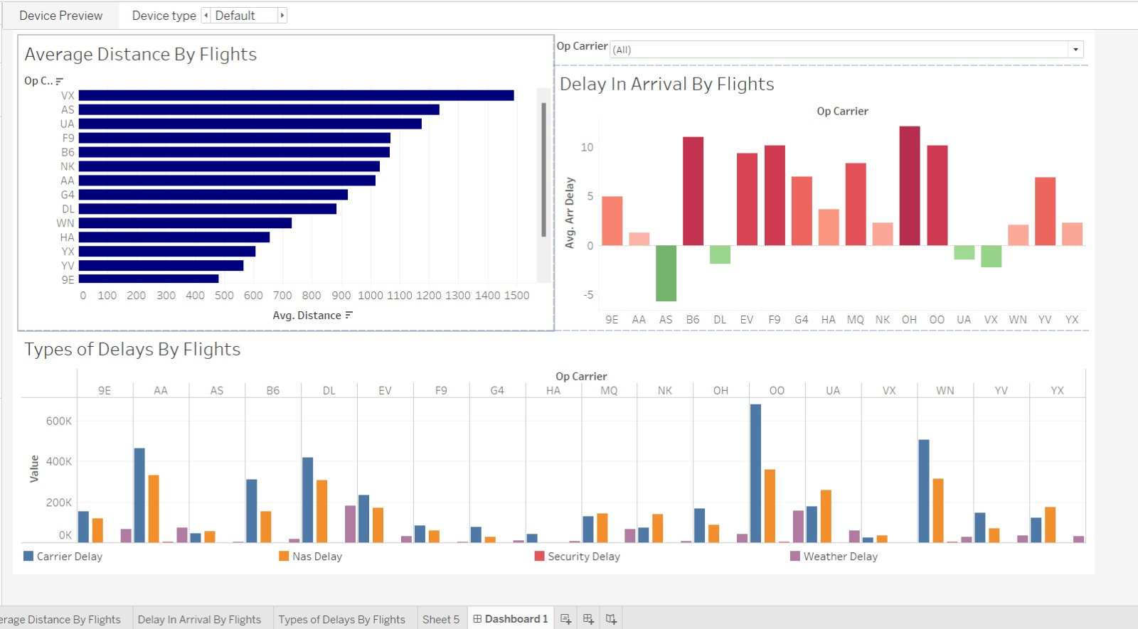
TABLEAU DASHBOARD
Fig 23. Dashboard for Raw data

Slide 23
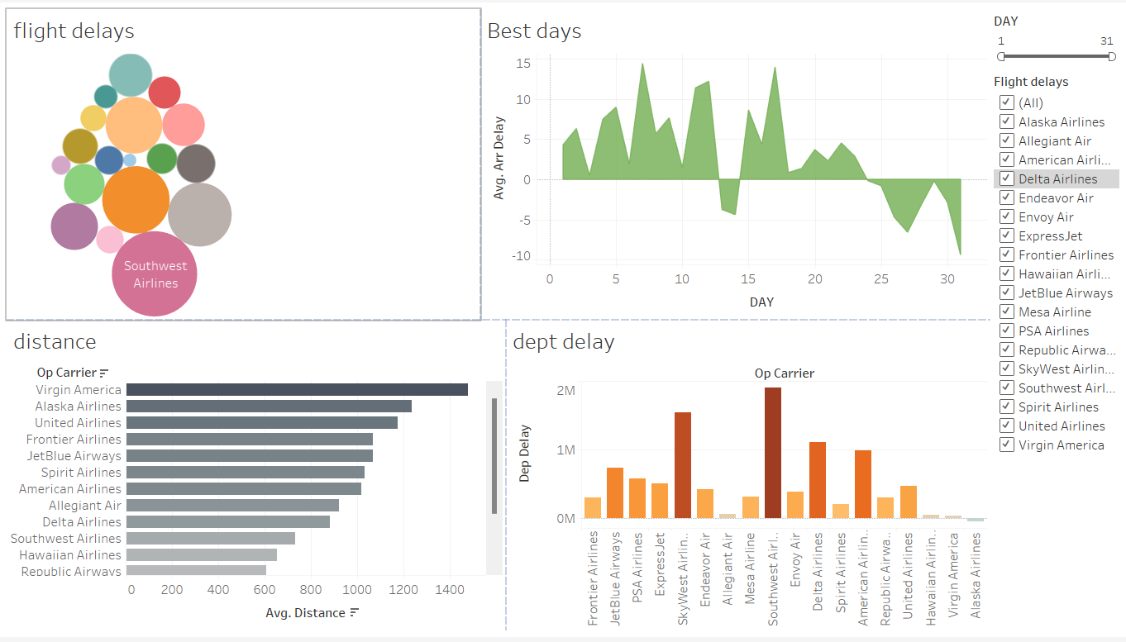
TABLEAU DASHBOARD

Slide 24
Modelling with ADABOOST
AdaBoost is short for Adaptive Boosting. Basically, Ada Boosting was the first successful boosting algorithm developed for binary classification.
Generally, AdaBoost is used with short decision trees. Further, the first tree is created, the performance of the tree on each training instance is used. Also, we use it to weight how much attention the next tree. Thus, it is created should pay attention to each training instance.
Hence, training data that is hard to predict is given more weight. Although, whereas easy to predict instances are given less weight.
The misclassification rate is calculated for the trained model. Traditionally, this is calculated as: error = (correct – N) / N. Where error is the misclassification rate. While correct is the number of training instance predicted by the model. And N is the total number of training instances.
By calculating the weighted average of the weak classifiers, predictions are formed.
Each weak learner determines a predicted value as either +1.0 or -1.0 for a new input instance. Each weak learners stage value is used to weight the anticipated values.
The ensemble model's forecast is calculated as the average of the weighted predictions. The first class is predicted if the sum is positive, and the second class is predicted if the sum is negative.

Slide 25
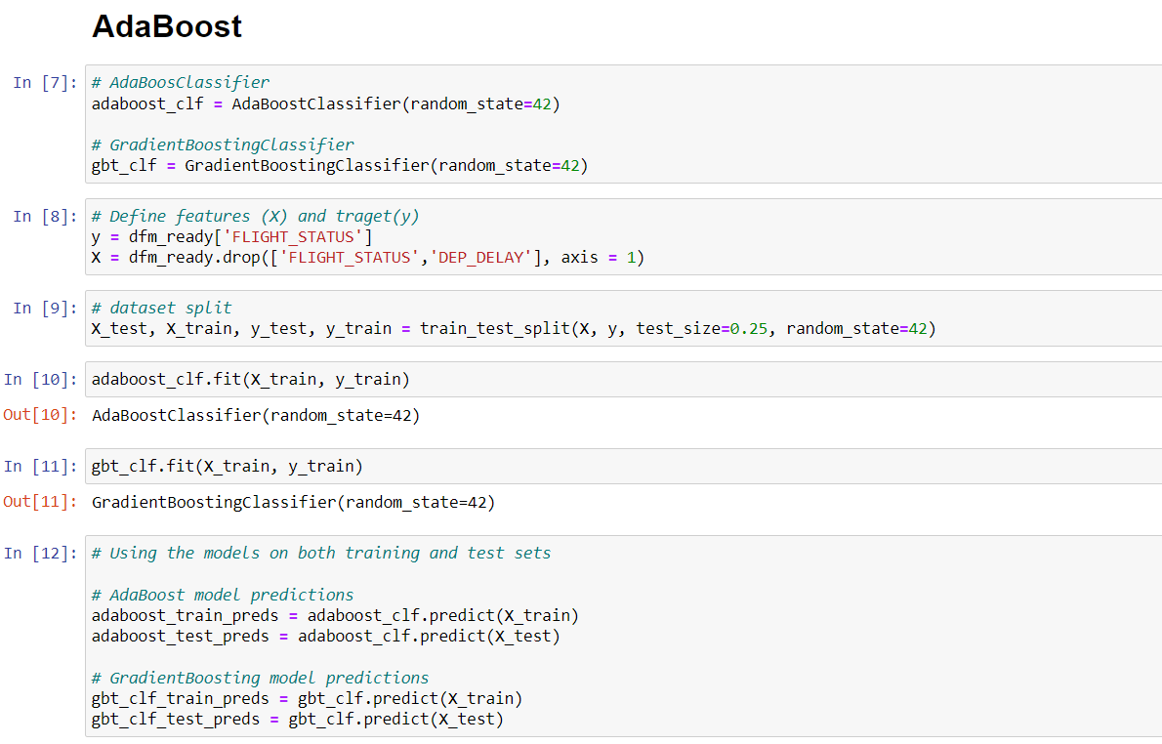
Fig 24. Adaboost training model

Slide 26
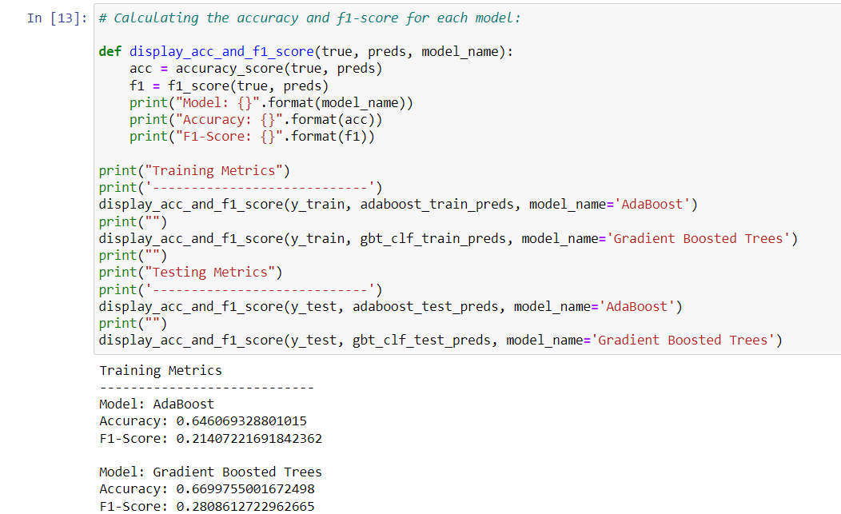
Fig 25. Checking accuracy

Slide 27
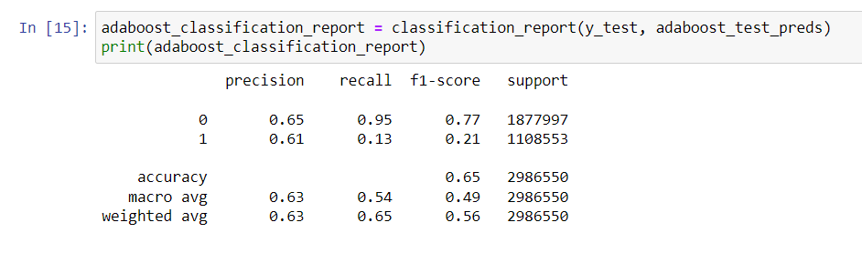
Fig 26. Classification report

Slide 28
Modelling with XGBOOST
XG-Boost Algorithm is an implementation of gradient boosted decision trees. That was designed to speed an performance.
Basically, XG-Boosting is a type of software library. That you can download and install on your machine. Then have to access it from a variety of interfaces.
Three main forms of gradient boosting are supported:
Gradient Boosting - This is also called as gradient boosting machine including the learning rate.
Stochastic Gradient Boosting - This is the boosting with sub-sampling at the row, column, and column per split levels.
Regularized Gradient Boosting - It includes boosting with both L1 and L2 regularization.
Features:
Flexibility - XGBoosting supports user-defined objective functions with classification, regression and ranking problems. We use an objective function to measure the performance of the model. That is given a certain set of parameters. Furthermore, it supports user-defined evaluation metrics as well.
Availability - As it is available for programming languages such as R, Python, Java, Julia, and Scala.
Save and Reload - We can easily save our data matrix and model and reload it later. Let suppose, if we have a large dataset, we can simply save the model. Further, we use it in future instead of wasting time redoing the computation.

Slide 29
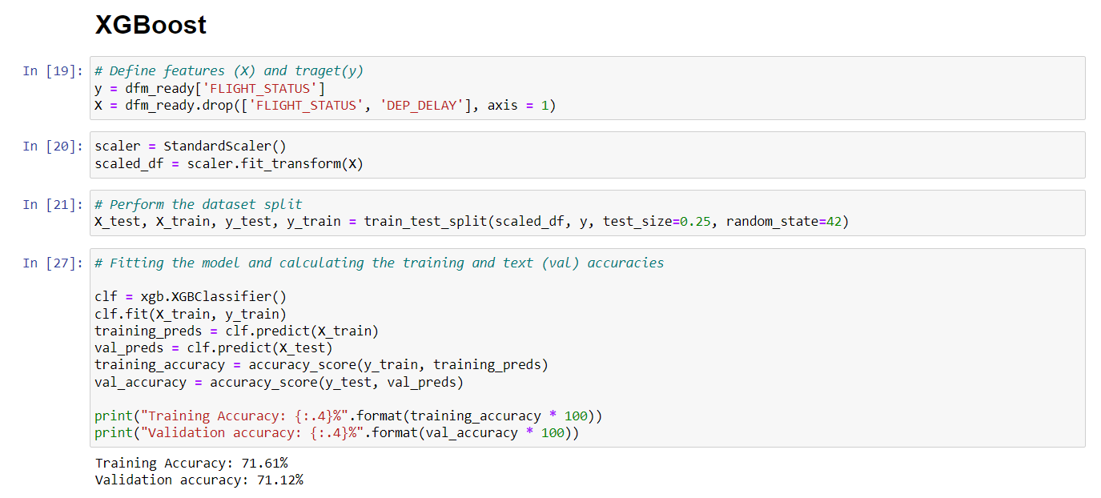
Fig 27. XGBOOST Model

Slide 30
Modelling with random forest
Random Forest is a powerful and versatile supervised machine learning algorithm that grows and combines multiple decision trees to create a “forest.”
The logic behind the Random Forest model is that multiple uncorrelated models (the individual decision trees) perform much better as a group than they do alone. When using Random Forest for classification, each tree gives a classification or a “vote.”
The forest chooses the classification with the majority of the “votes.” When using Random Forest for regression, the forest picks the average of the outputs of all trees.
The key here lies in the fact that there is low (or no) correlation between the individual models—that is, between the decision trees that make up the larger Random Forest model.
While individual decision trees may produce errors, the majority of the group will be correct, thus moving the overall outcome in the right direction.
The key benefits of using Random Forest are:
Ease of use
Efficiency
Accuracy
Versatility – can be used for classification or regression
More beginner friendly than similarly accurate algorithms like neural nets

Slide 31
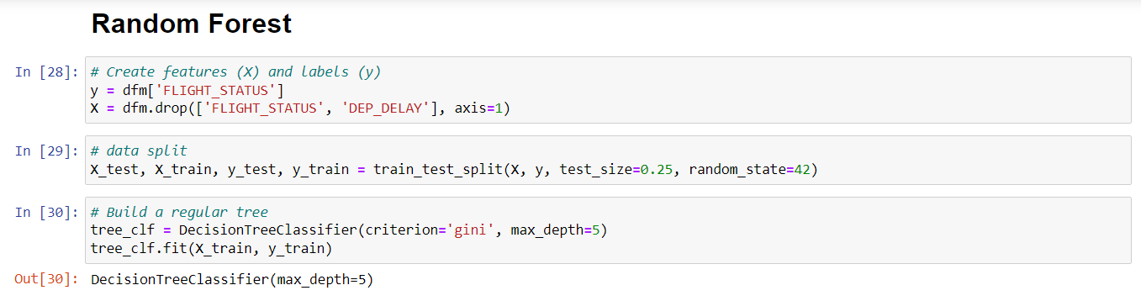
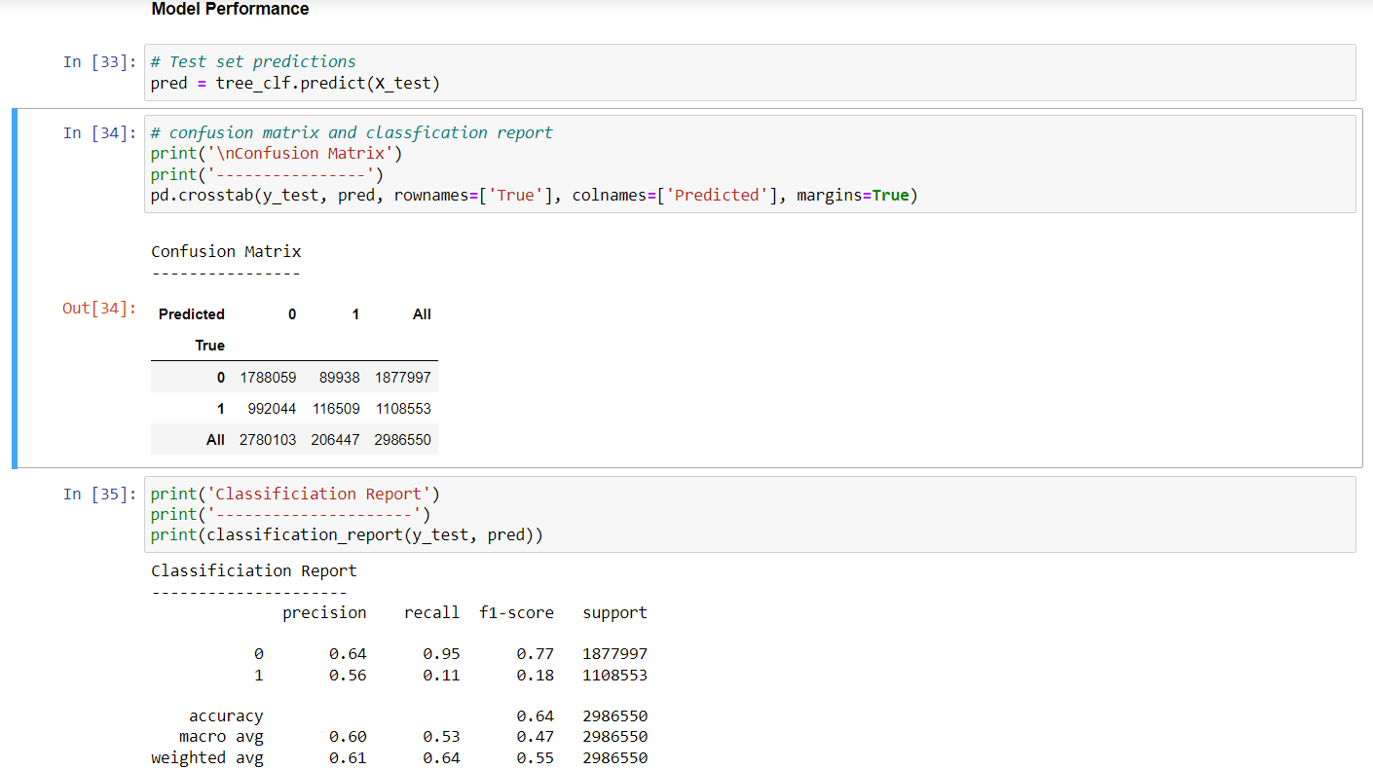
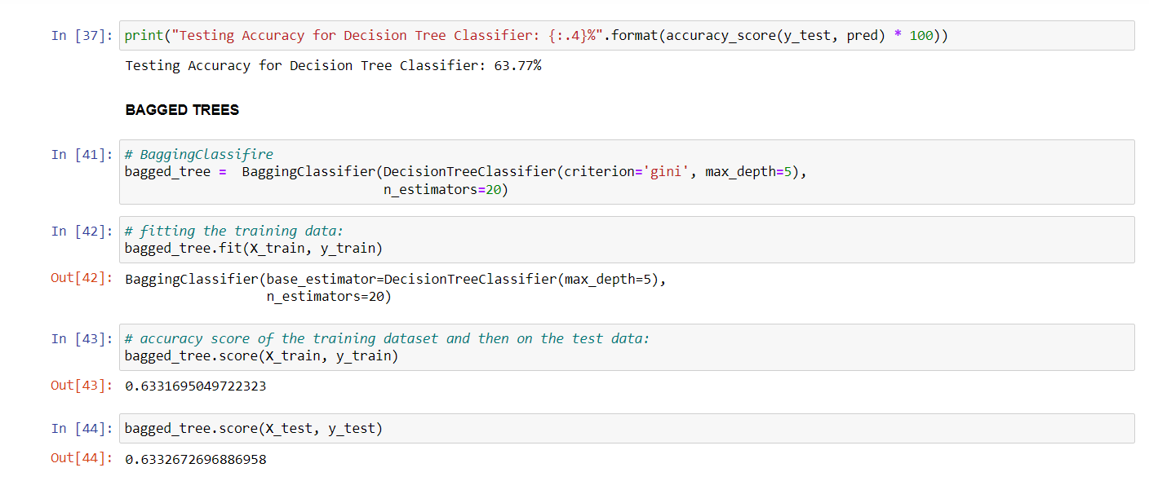
Fig 28. Model Performance

Slide 32
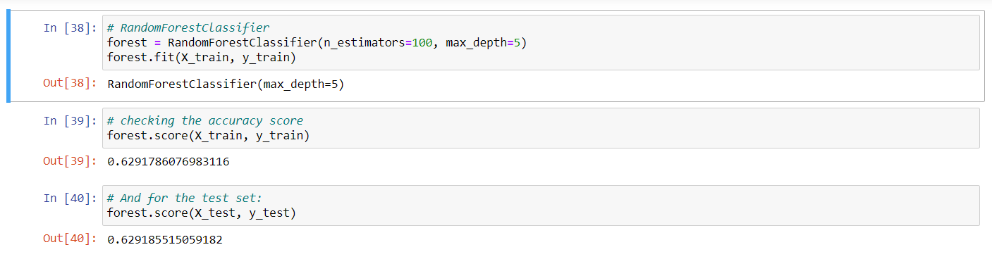
Fig 29. RandomForestClassifier

Slide 33
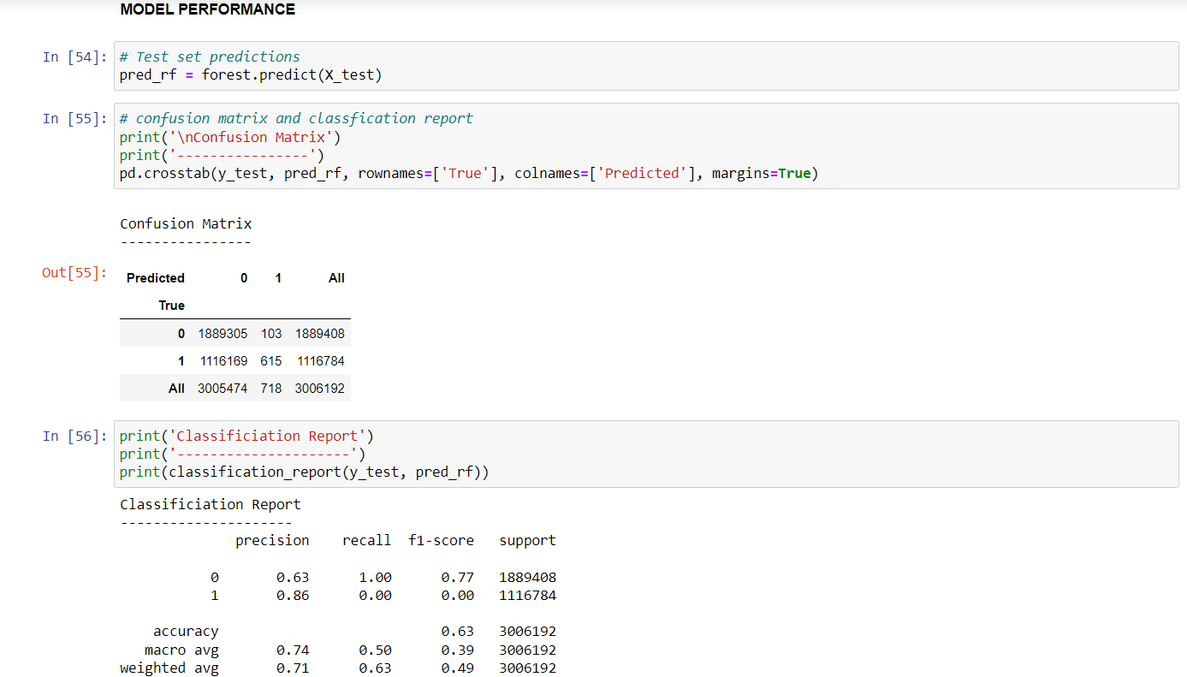
Fig 30. Model Performance

Slide 34
challenges
Ghosting flights – There were flights with no WHEELS_ON or ARR_TME. Such flights never landed. So, we should find a way to include these flights or to deal with them in some way to enhance accuracy of the model.
There might be more than 1 airport in 1 city so, dealing with repeated airports is also something we should deal with to increase the accuracy of our predictions.
Since the dataset has multiple files for different years, ranging from 2008 to 2018. We should come up with a model which can handle all the files at once and give a more concreate result in terms of accuracy.
The scope of the project is confined to USA, if we include more countries and international flight data as well the models should be able to handle multiple features and still give the best accuracy.

Slide 35
CONCLUSION
In this project we were able to:
Perform EDA on the dataset and discover findings like Total number of flights per airlines, better days to travel, impact of delayed flights, popular destinations with average airline delay etc and visualize them.
Found that Delta and Alaska Airlines are two of the most reliable airlines with the lowest number of delayed flights.
Visualize the raw dataset on Tableau and create a dashboard with filters which made it easy to navigate through the columns of the dataset and helped exploring the data in a more visual and interactive way.
Predict if a flight will be delayed or not even before it is displayed on the board, using various models like XGBoost, ADABoost and Random forest prediction models.
Compare the accuracy of three different prediction models and found the one which helps providing the best accuracy.

Slide 36
THANK YOU

